Slide 1

Kausale Effekte in der Persönlichkeitspsychologie
Felix Thoemmes Juni, 2022

Slide 2
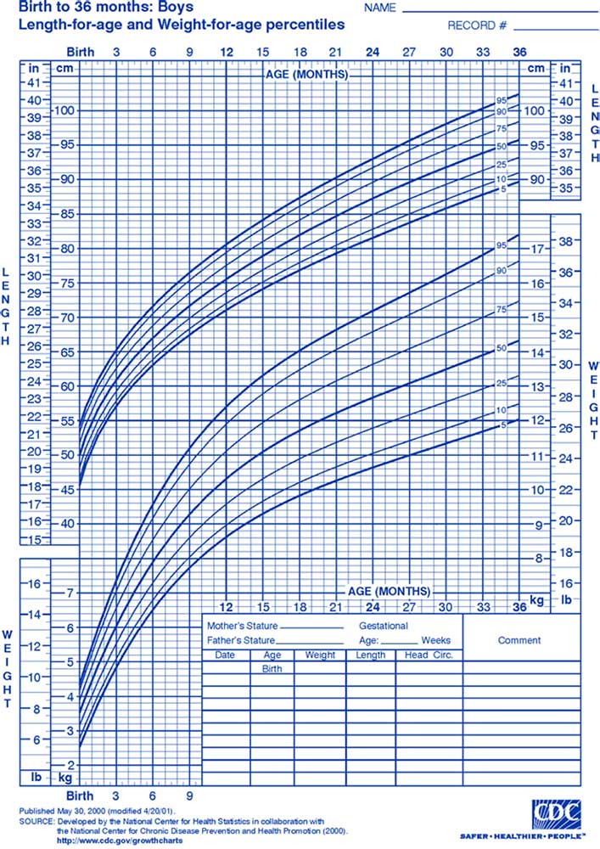
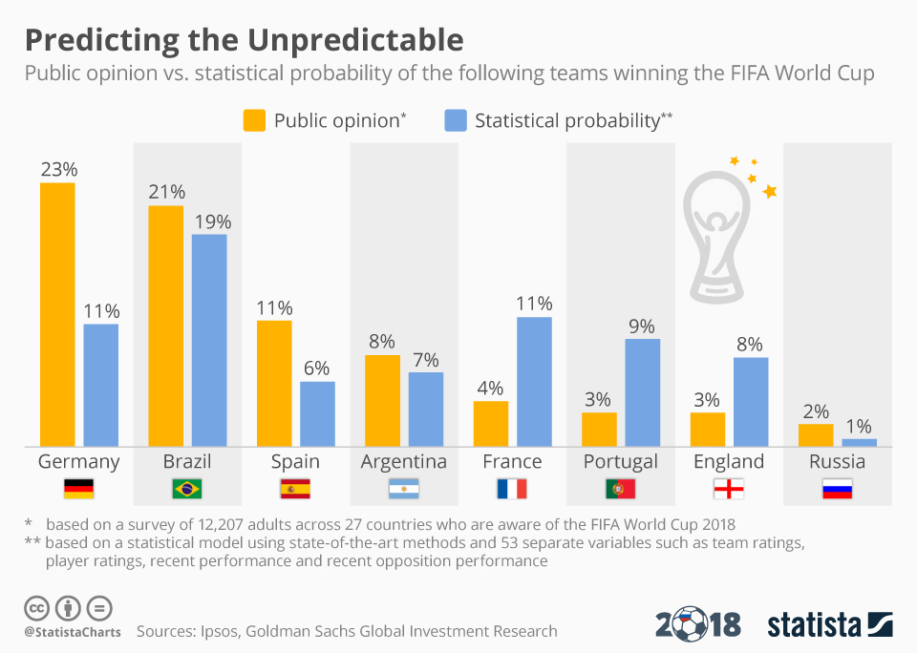
Wir brauchen nicht immer kausale Inferenz
Deskription
Prognose

Slide 3


Slide 4
Wann brauchen wir kausale Inferenz?
Um “kausale” Fragen zu beantworten
Wird meine Intervention eine bestimmte Variable beeinflussen?
Zur Theorienbildung

Slide 5
Kausalität
“No causes in, no causes out.” Nancy Cartwright, “Hunting Causes and Using Them”
Statistik allein lässt keine kausale Inferenz zu
Man benötigt immer (un-testbare) Annahmen

Slide 6
Brainstorm

Slide 7
(Wenig) Theorie und Grundlagen

Slide 8

TREATMENT
Unit –level Causal Effect
CONTROL

Slide 9

TREATMENT
CONTROL
Average Causal Effect

Slide 10
TREATMENT
CONTROL
Estimate of the Average Causal Effect

Slide 11
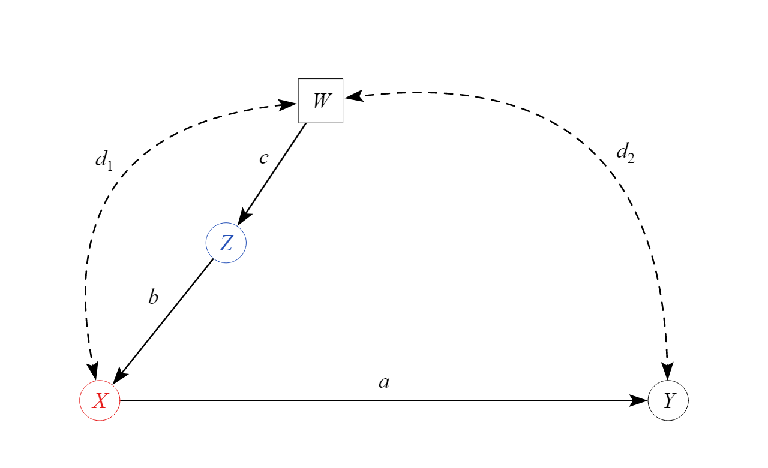
DAGs
Buchstaben sind Variablen
Pfeile sind angenommene kausal Effekte

Slide 12
DAGs
Pfeil mit einer Spitze ist angenommer kausaler Effekt zwischen zwei Variablen
Pfeil mit zwei Spitzen is angenommener kausal Effekt einer dritten Variable zwischen zwei Variablen (latente Variable)
Pfeile setzen keine spezielle parametrische Form voraus

Slide 13
Pfade
Front-door + open → causal path
Front-door + closed → neutral, but biasing (for total effect) if opened
Back-door + open → biasing path
Back-door + closed → neutral, but biasing if opened

Slide 14
Strategien

Slide 15
Unconfoundeness
Mechanisms
Instrumental variables
Front-door criterion
Regression
Matching
Weighting
Latente Variablen
Längsschnittliche Analysen

Slide 16
Instrumental variables

Slide 17
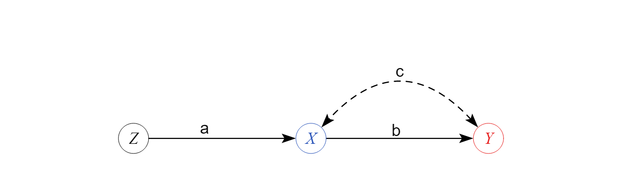

Slide 18
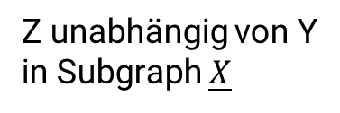
Annahmen
Z ist nicht unabhängig von X (F-test der Regression > 10)
Kein direkter Pfad von Z auf Y
Z unabhängig von allen Variablen die Pfad c induzieren
Z unabhängig von Y in Subgraph $\underline{X}$

Slide 19
Annahmen
Wenn Annahmen nicht erfüllt sind, ist der IV estimate biased
Nur Annahme der Abhängigkeit von Z und X testbar, alle anderen nicht testbar (in tri-variaten Modellen)

Slide 20
Annahmen
Heterogene Effekte nicht schätzbar, sondern nur Effekt für Individuen die von Z beinflussbar sind (complier average effect)
Anderer Effekt für jedes andere Instrument
Statistische Power geringer als Regression

Slide 21
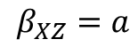
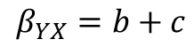
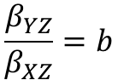
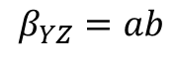
$$β_{XZ}=a$$
$$β_{YX}=b+c$$
$$β_{YZ}=ab$$
$$\frac{β_{YZ}}{β_{XZ}}=b$$
IV estimate ist unbiased
regression estimate ist biased (c)

Slide 22
Statistisches Modell
2SLS oder SEM
Orthodox wird erst Regression von Z auf X (1st stage) und dann 2SLS estimate berichtet

Slide 23
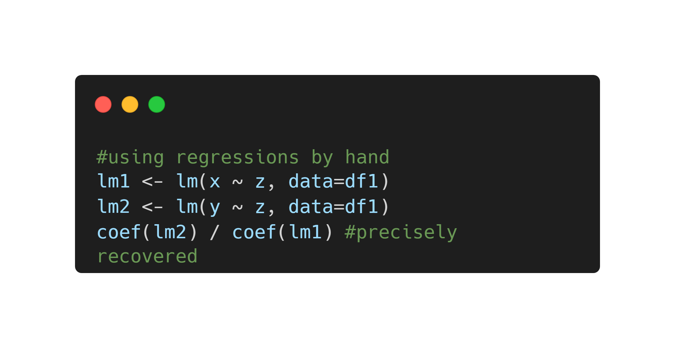

Slide 24
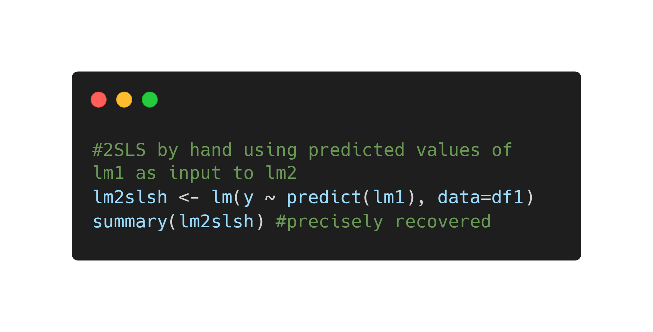

Slide 25
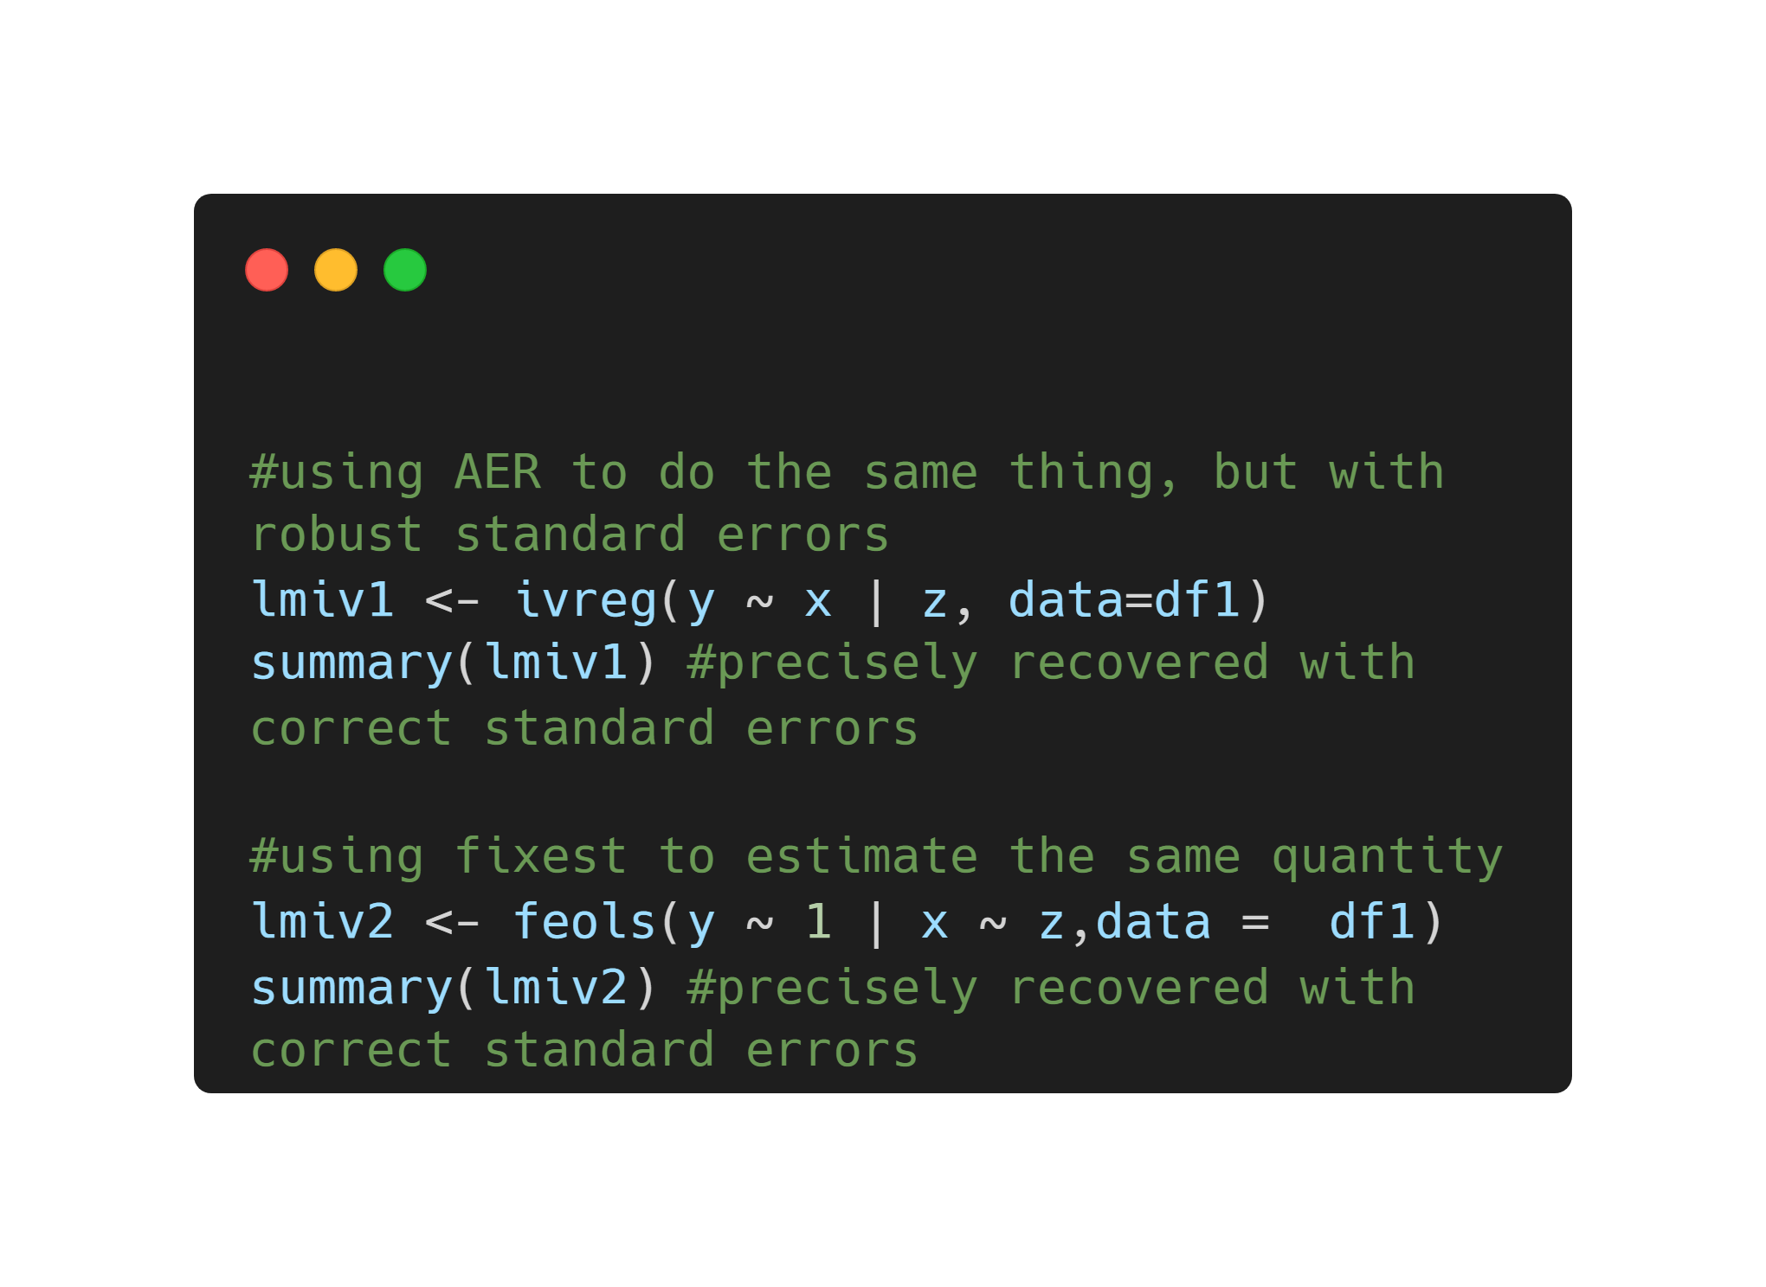

Slide 26
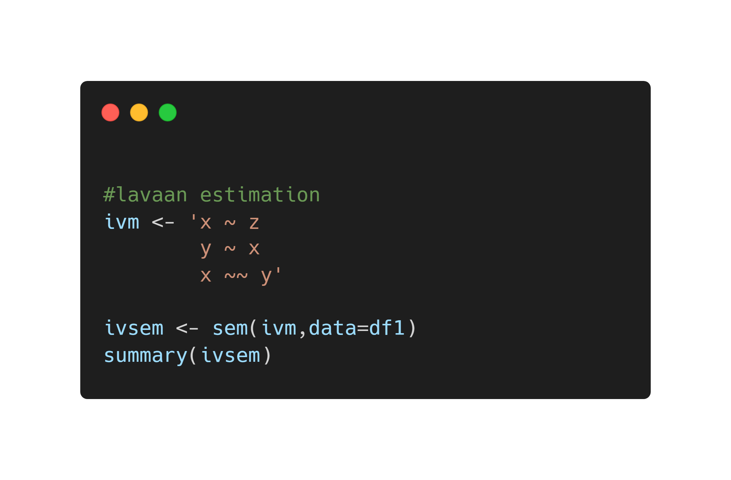

Slide 27
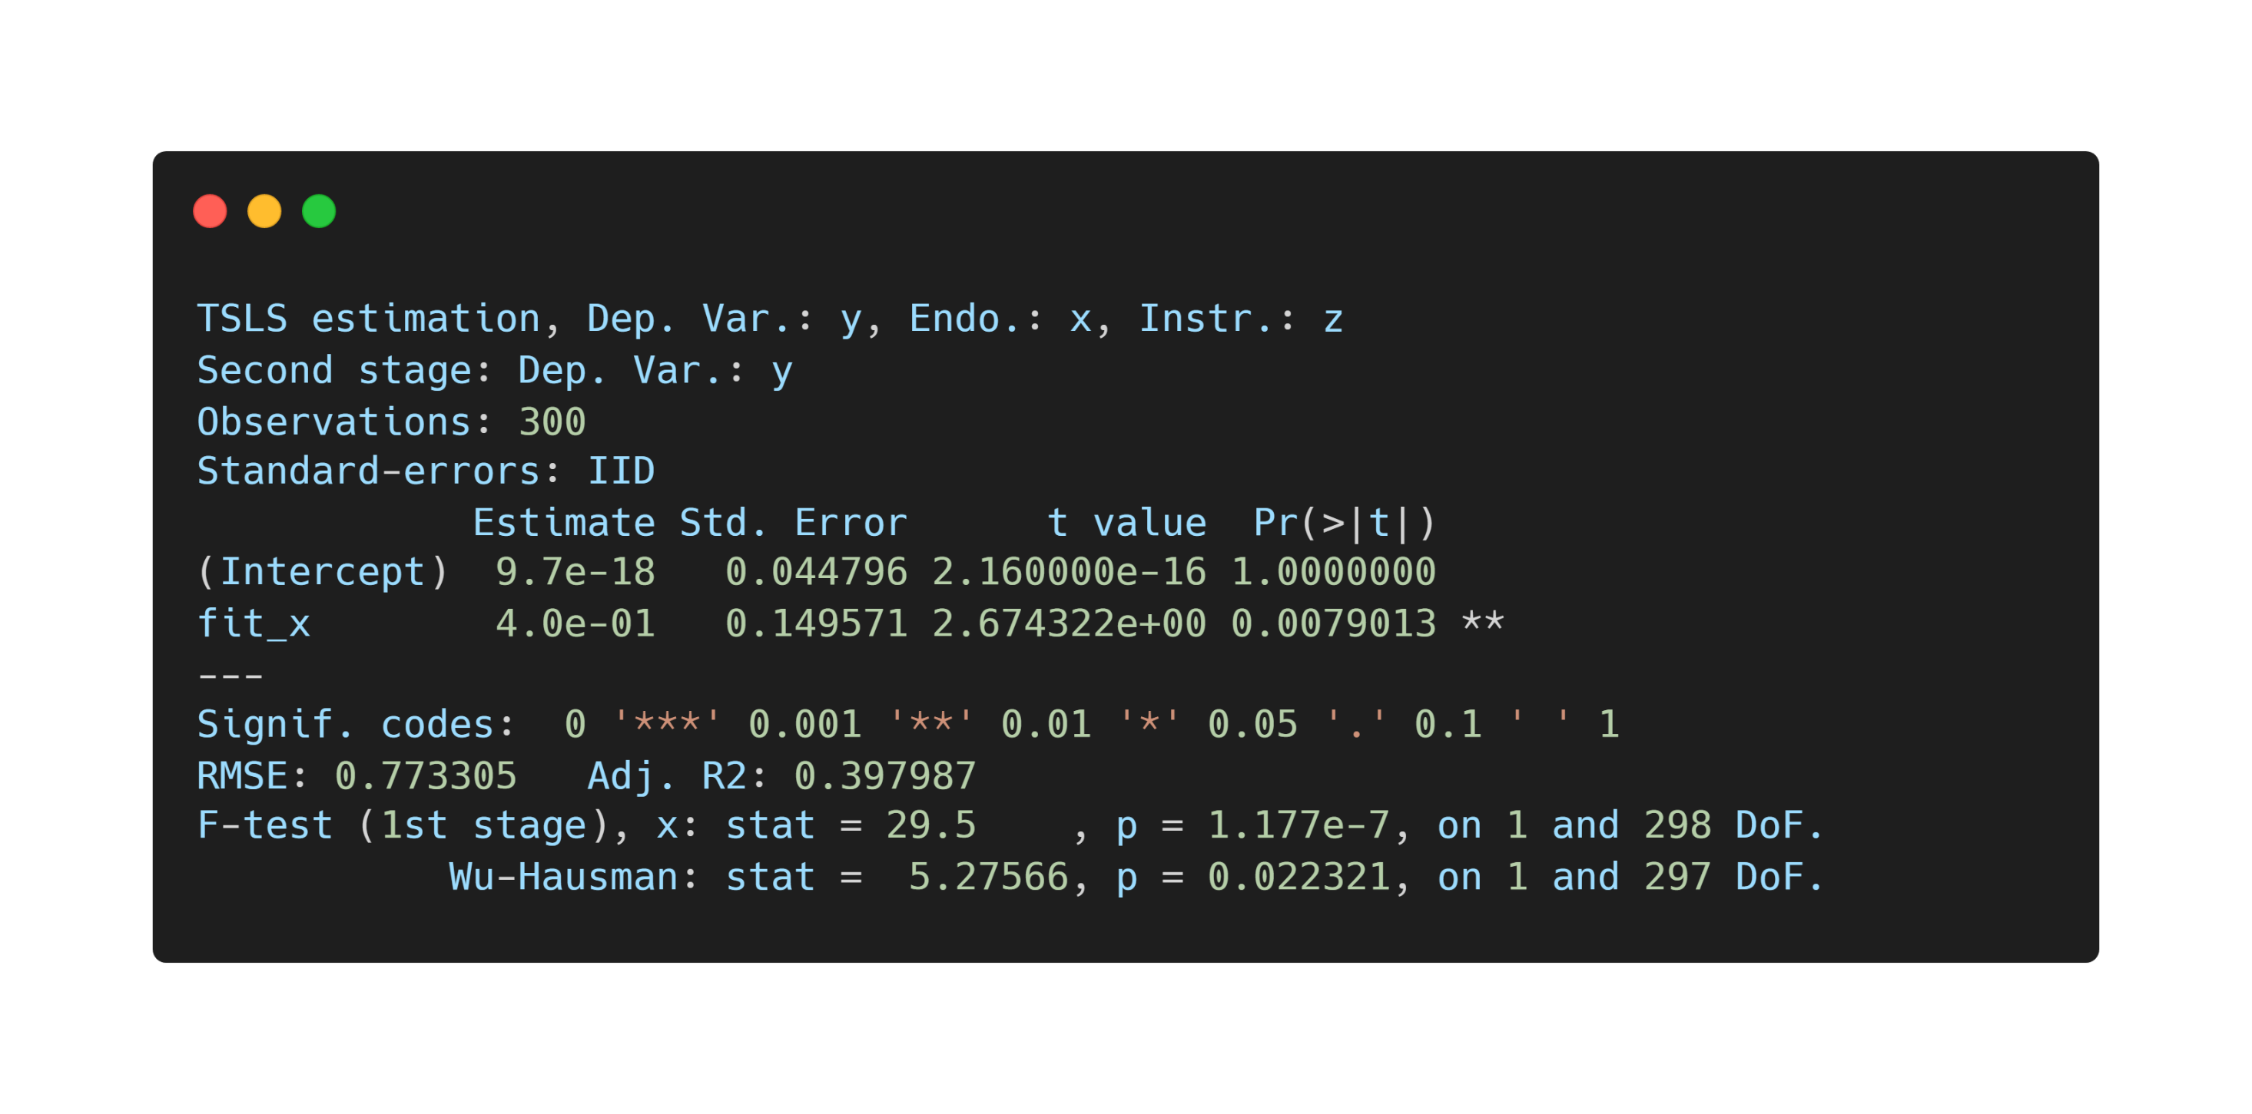

Slide 28
Exercise 1

Slide 29
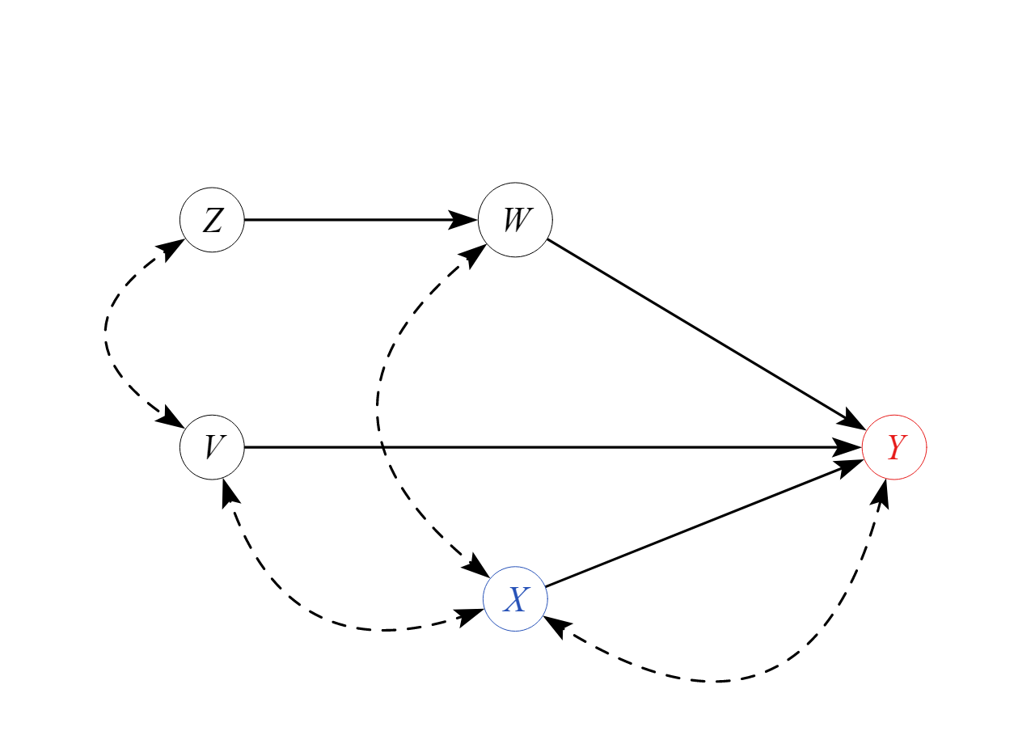

Slide 30
Front-door

Slide 31
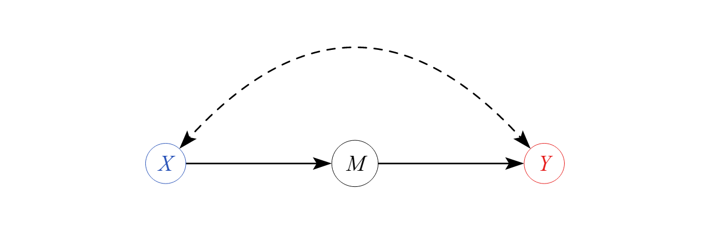

Slide 32
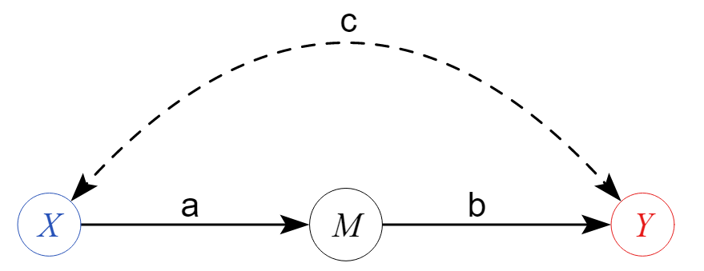
Annahmen
Kein anderer Pfad zwischen X und Y, außer M (full mediation)
Kein back-door Pfad zwischen X und M
Kein back-door Pfad zwischen M und Y, der nicht von X blockiert werden kann

Slide 33
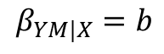
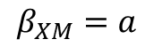
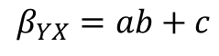
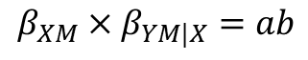
$$β_{XM}=a$$
$$β_{YX}=ab+c$$
$$β_{YM|X}=b$$
$$β_{XM}×β_{YM|X}=ab$$
FD estimate ist unbiased
regression estimate ist biased (c)

Slide 34
Statistisches Modell
Mediation model (zwei Regressionen) oder SEM

Slide 35
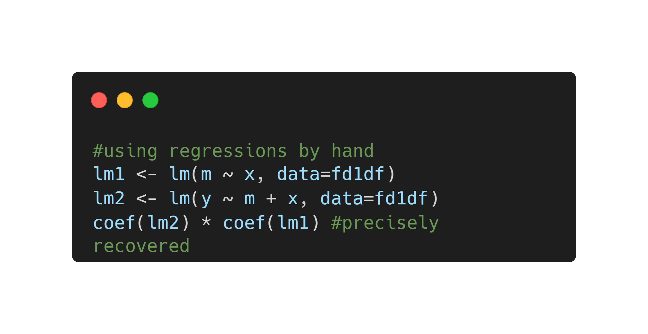

Slide 36
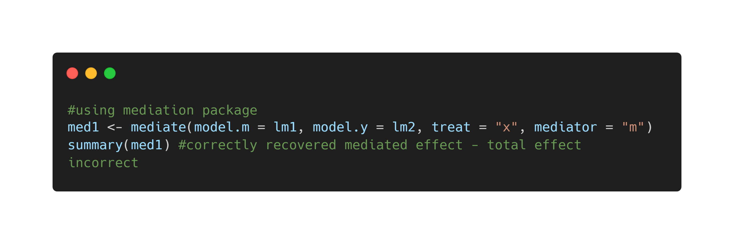

Slide 37
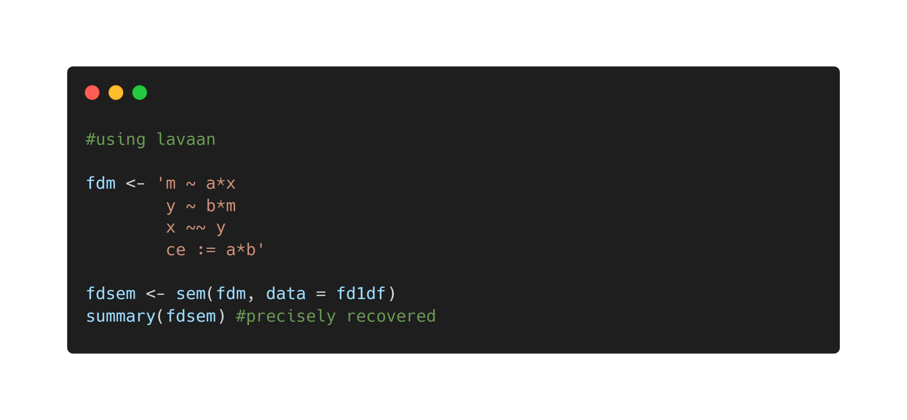

Slide 38
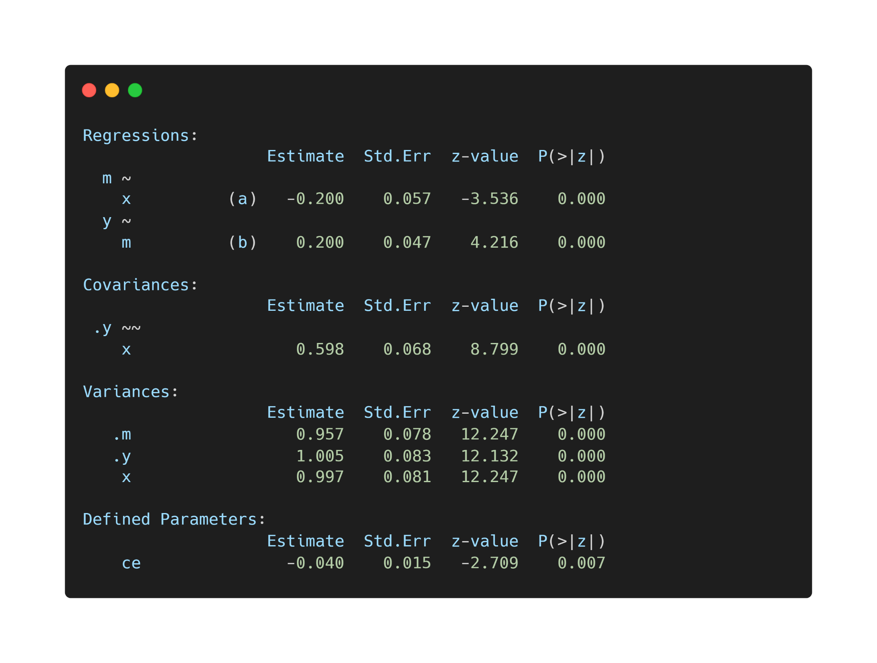

Slide 39
Exercise 2

Slide 40
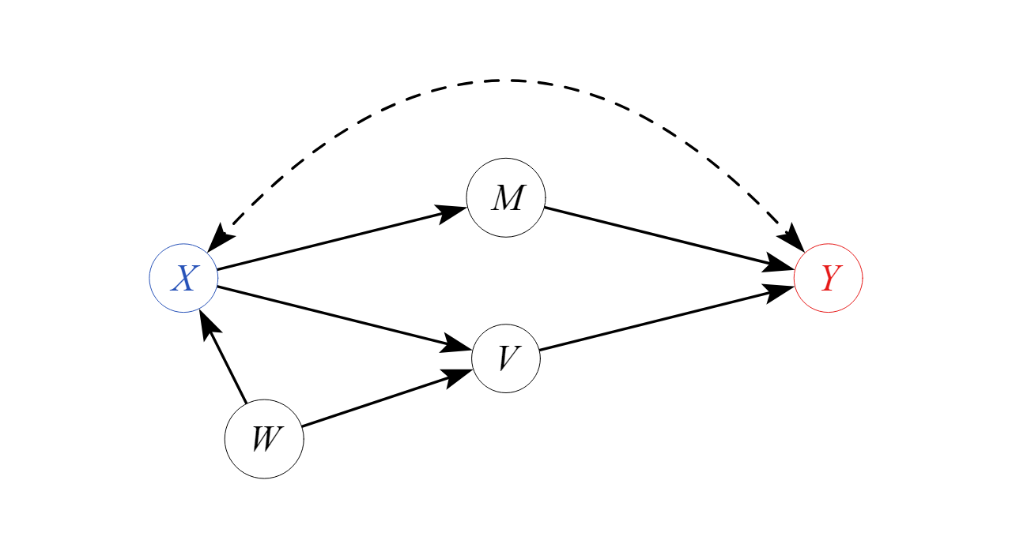

Slide 41
Regression

Slide 42
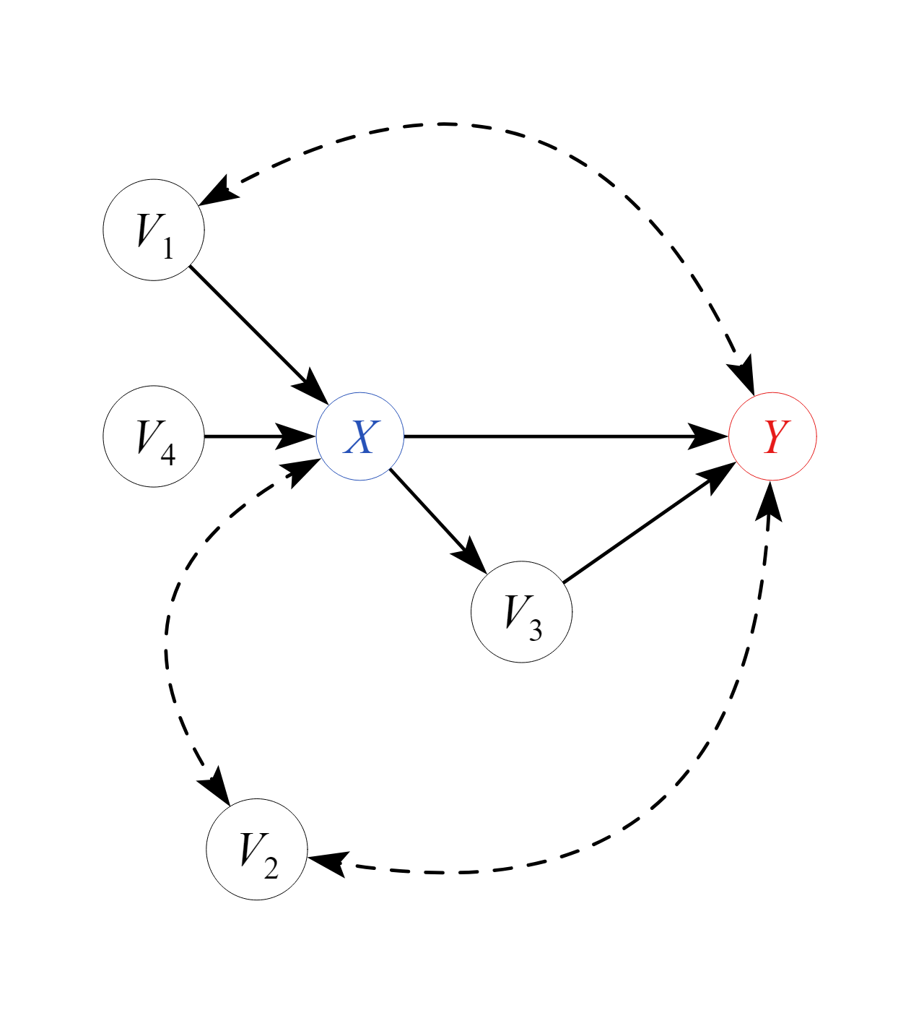

Slide 43

Annahmen
Alle back-door Pfade geschlossen
Keine kausalen front-door Pfade geschlossen

Slide 44
Statistisches Modell
Regression und „Average causal effect“

Slide 45
Statistisches Modell
Latente Variablen in SEM modellierbar („Effectlite“)

Slide 46
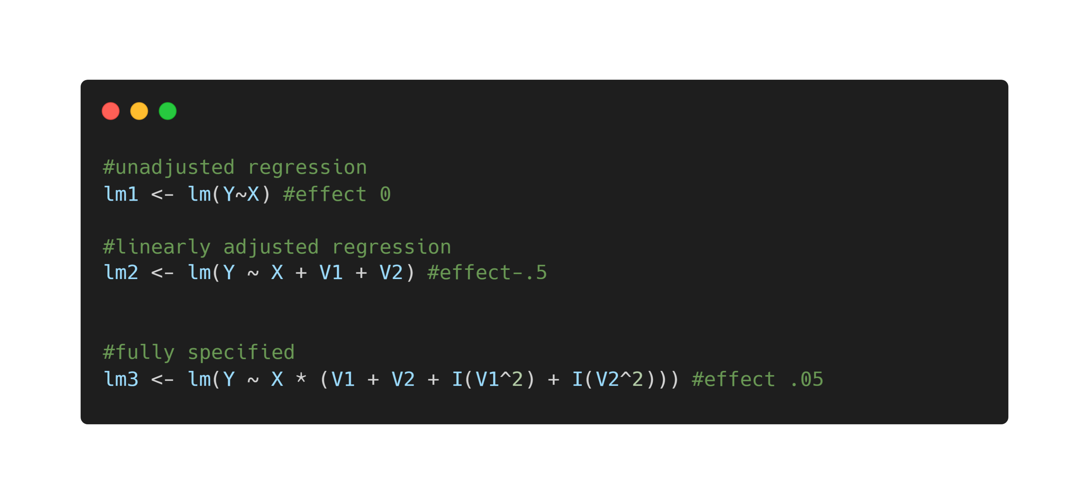

Slide 47
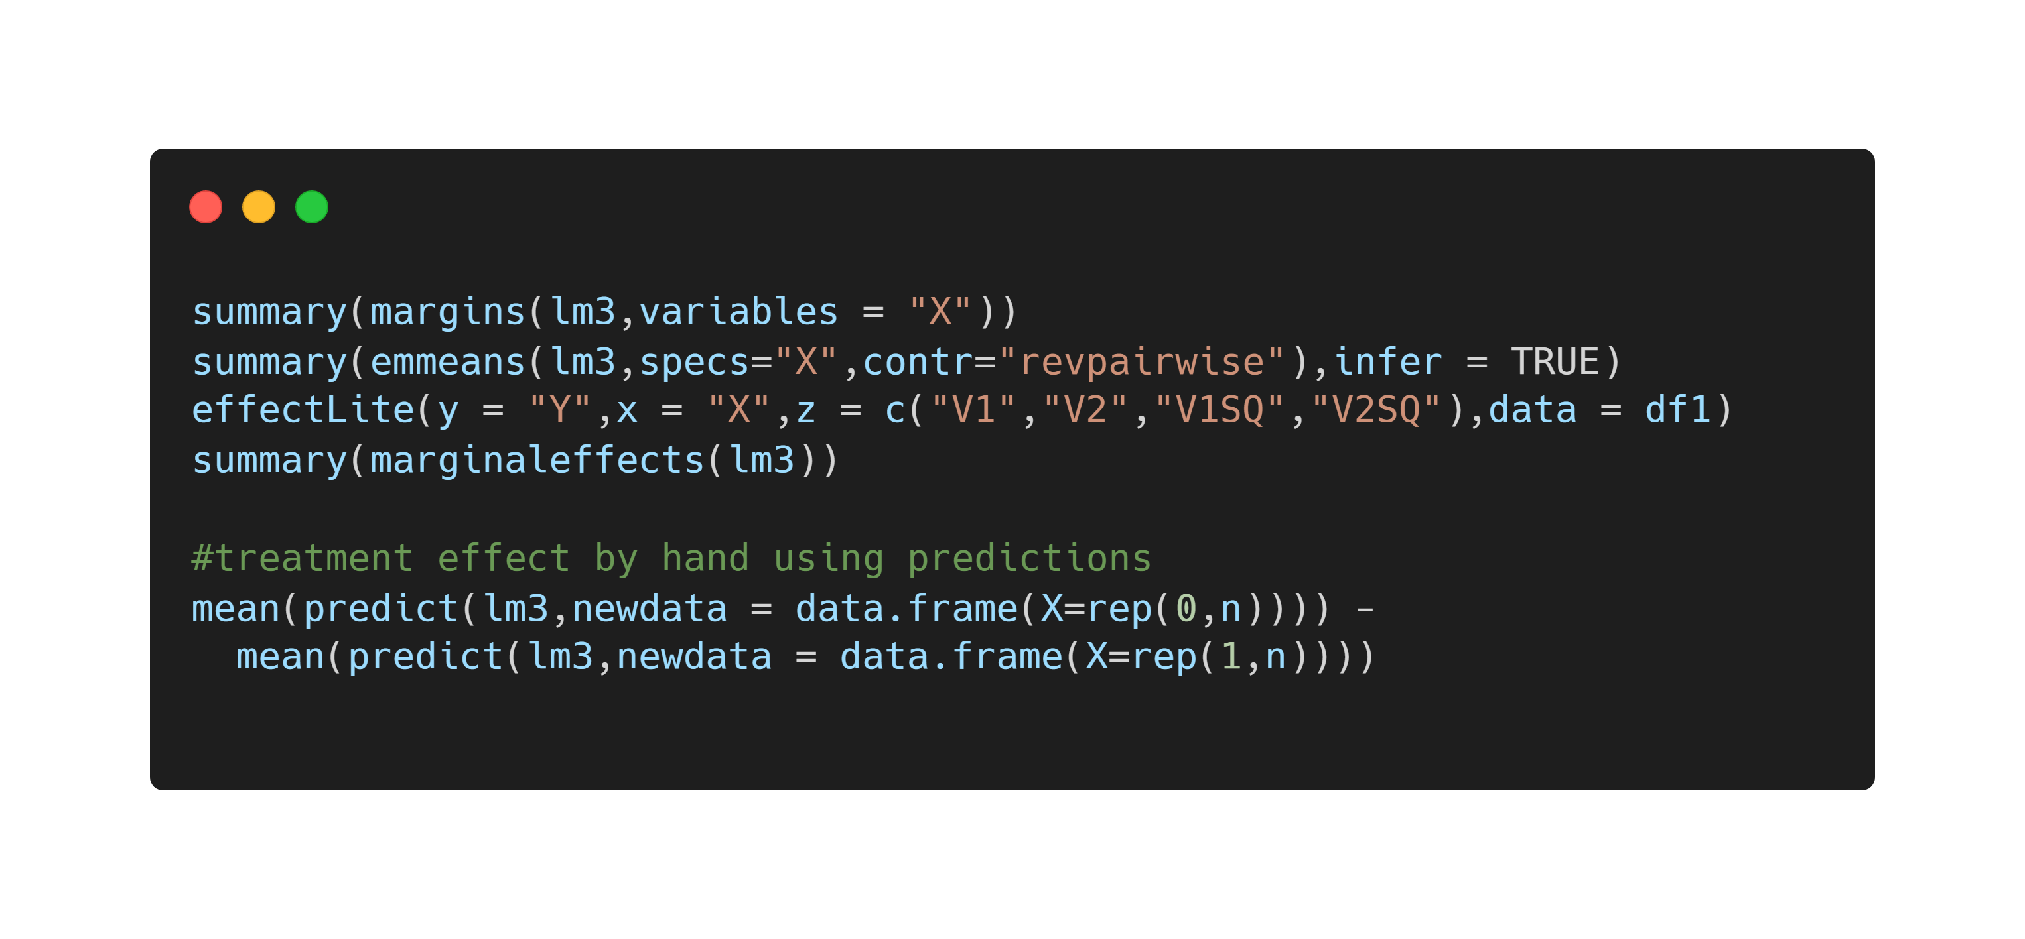

Slide 48
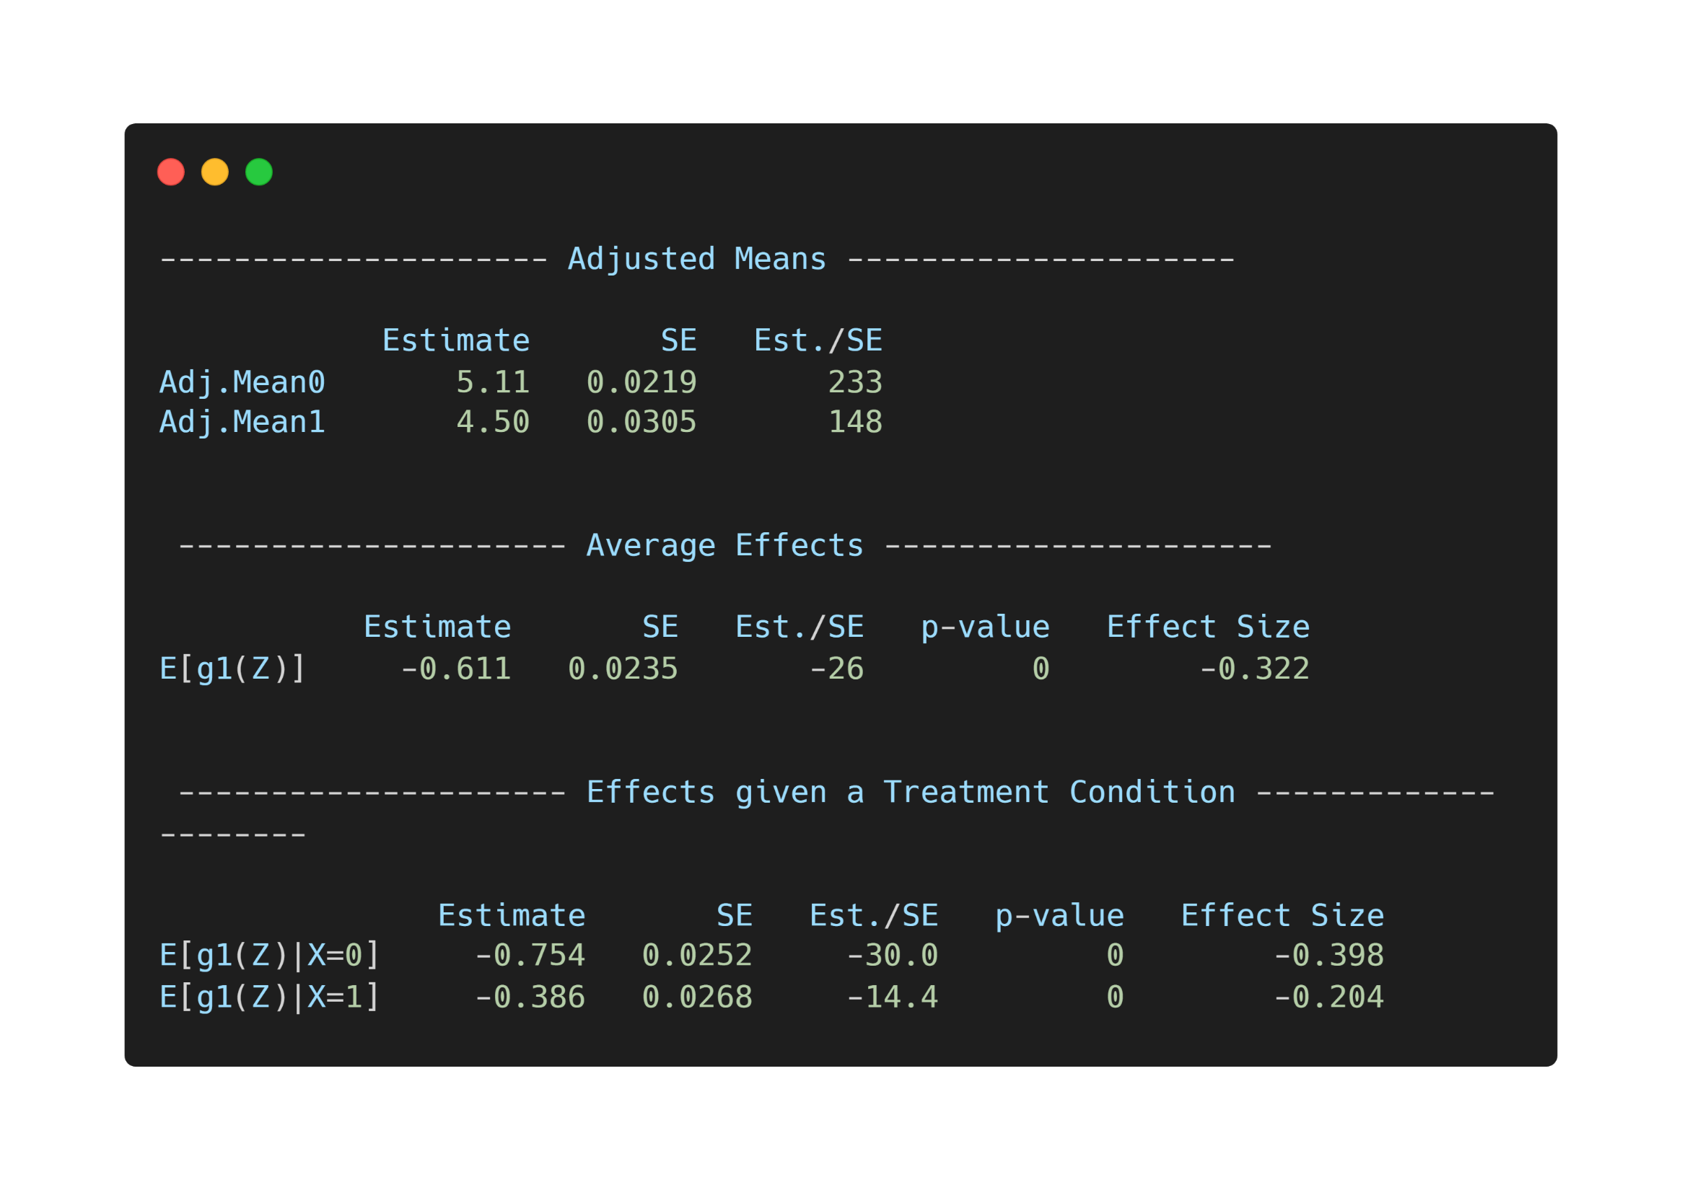

Slide 49
Exercise 3

Slide 50
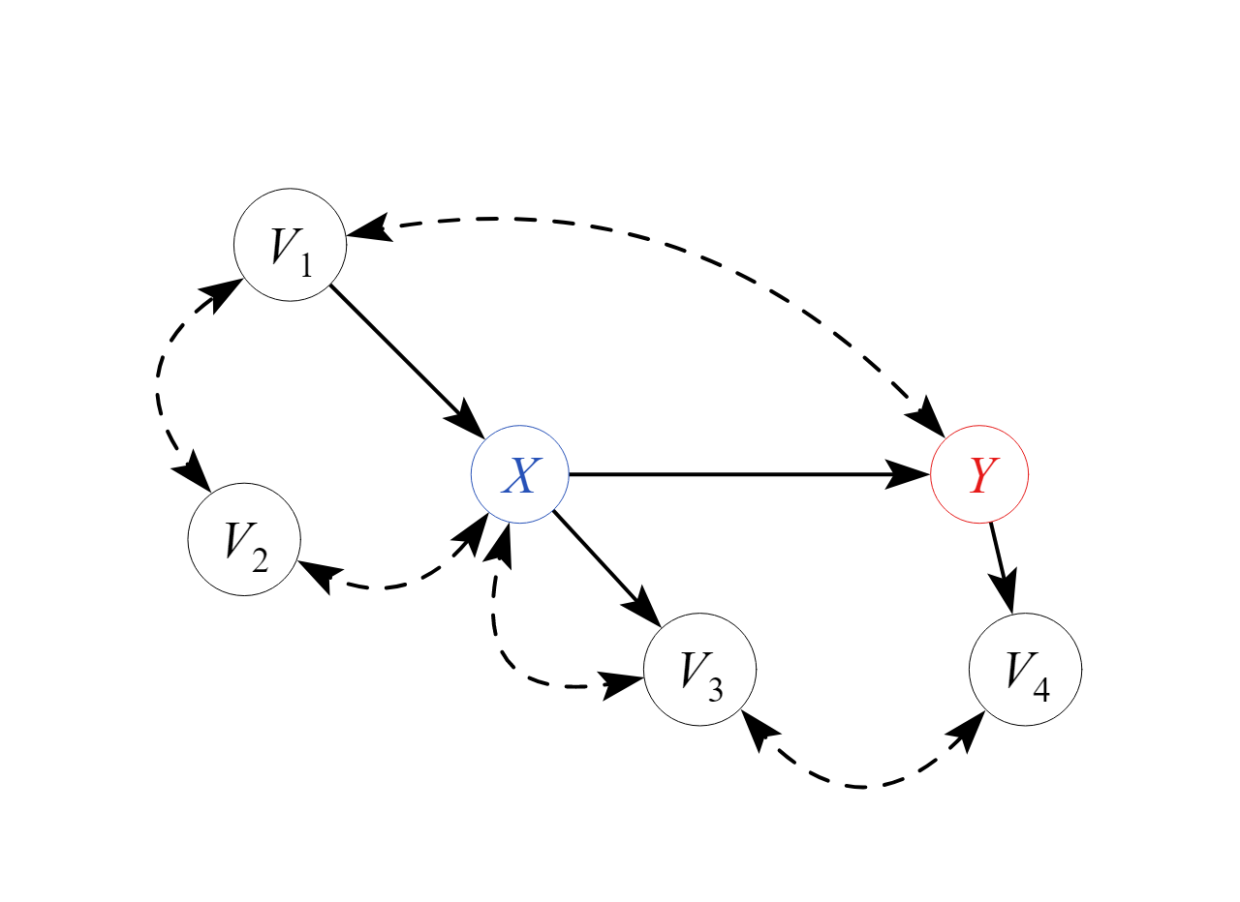

Slide 51
Matching

Slide 53
Annahmen
Alle back-door Pfade geschlossen
Keine kausalen front-door Pfade geschlossen

Slide 54

Annahmen
Identische Annahmen wie in der Regressionsanalyse
Modellierung normalerweise der Pfade von confoundern auf X (und nicht auf Y, wie in Regression)

Slide 55
Annahmen
In Kombination mit Regression ggf. doppelt robust (entweder matching oder Regression korrekt spezifiziert)

Slide 56
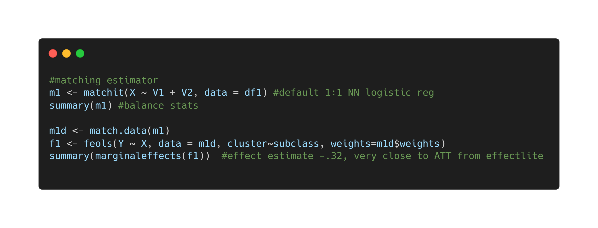

Slide 57
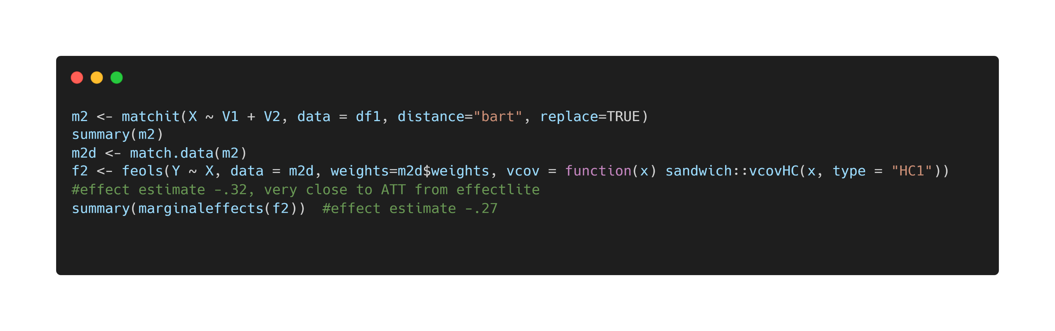

Slide 58
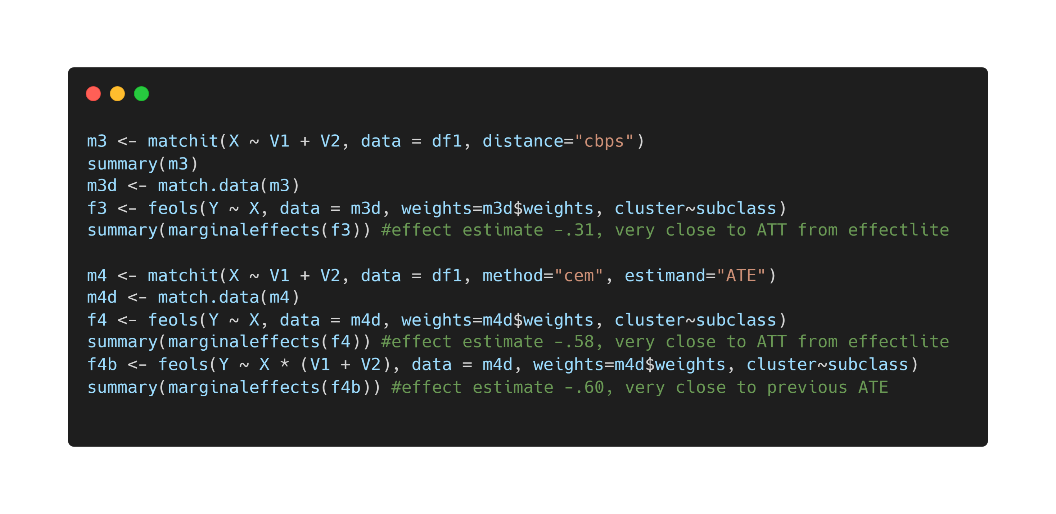

Slide 59
Exercise 4

Slide 60
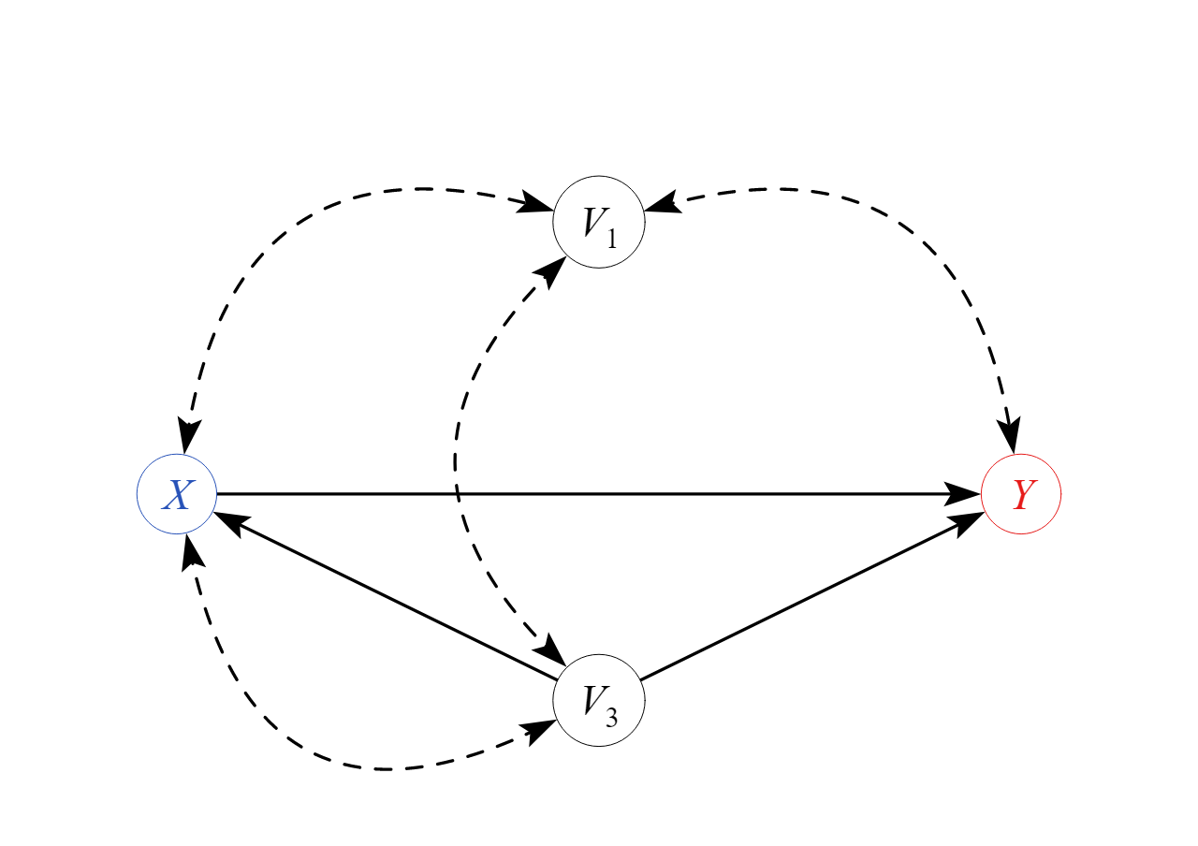

Slide 61
Weighting

Slide 63
Annahmen
Alle back-door Pfade geschlossen
Keine kausalen front-door Pfade geschlossen

Slide 64

Annahmen
Identische Annahmen wie in der Regressionsanalyse, matching
Modellierung der Gewichte (confounders auf X)
Gewichte simulieren Population in der Confounder und X unabhängig sind

Slide 65
Annahmen
In Kombination mit Regression ggf. doppelt robust (entweder Gewichte oder Regression korrekt spezifiziert)

Slide 66
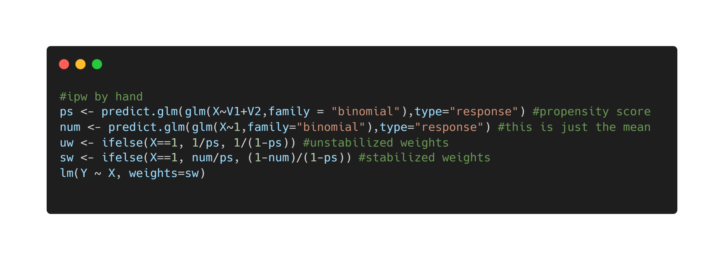

Slide 67
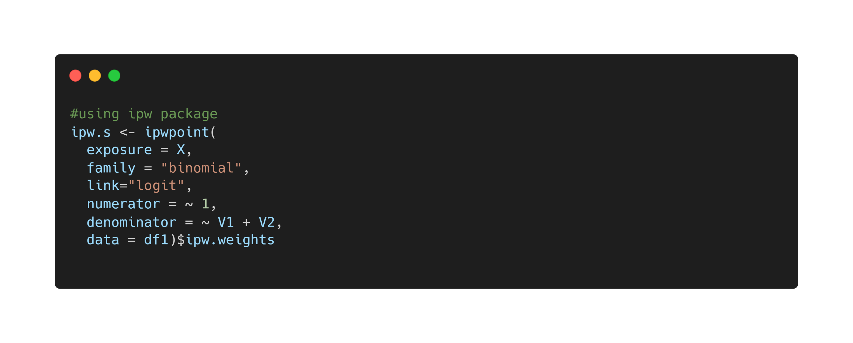

Slide 68
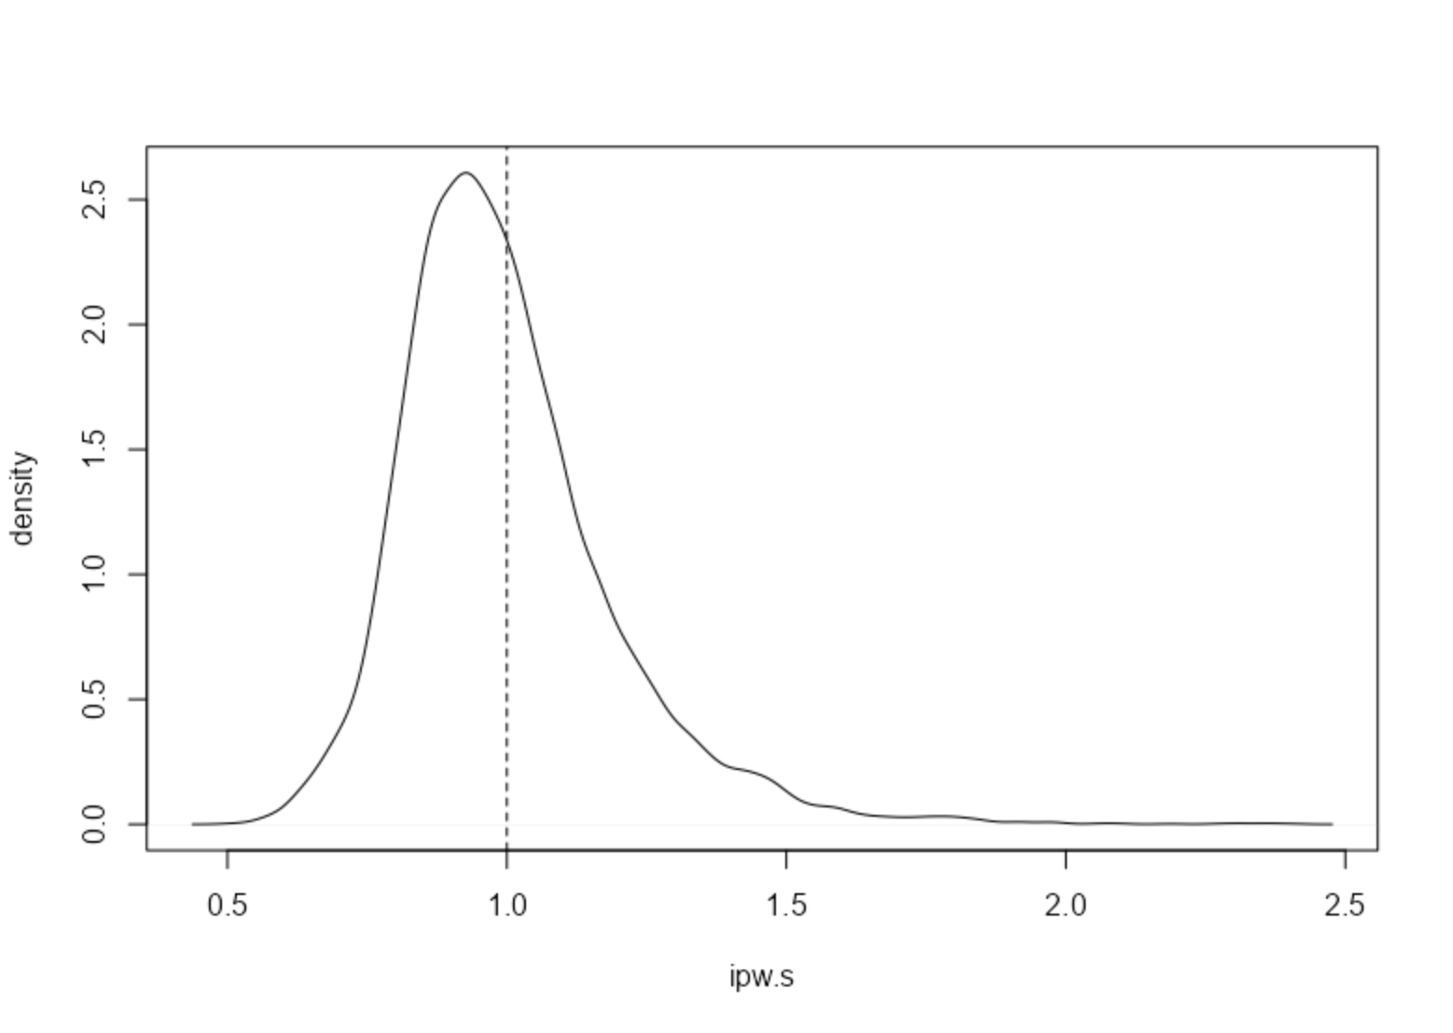

Slide 69
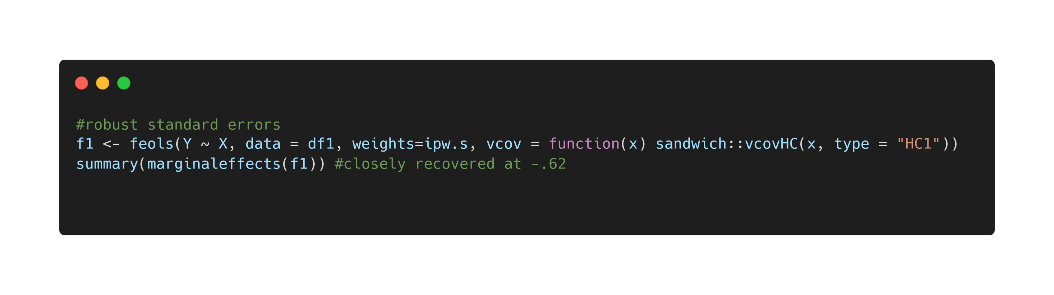

Slide 70
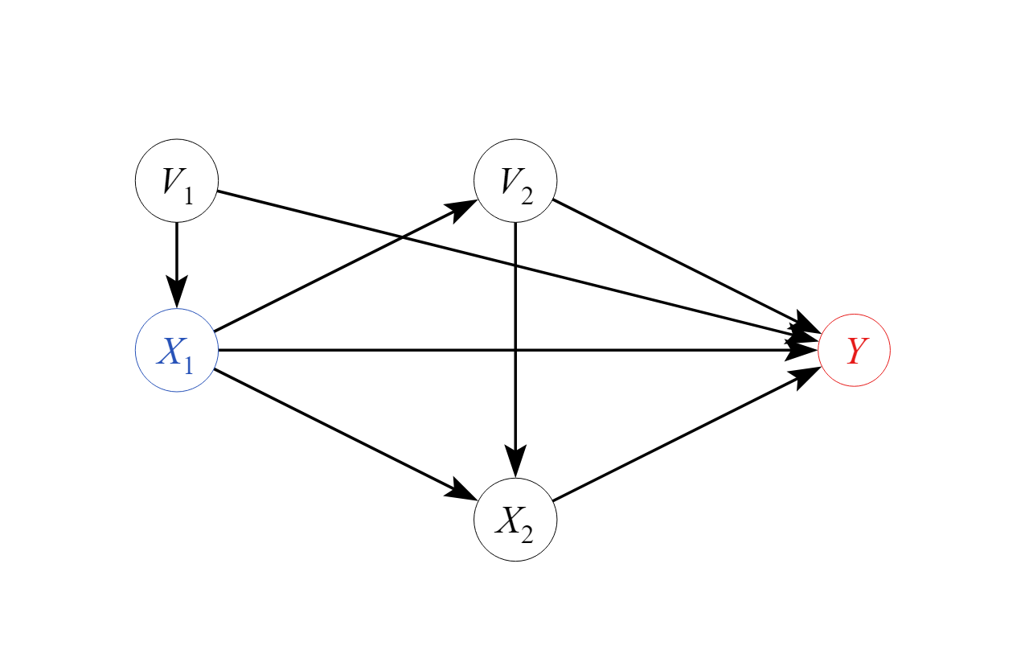

Slide 71
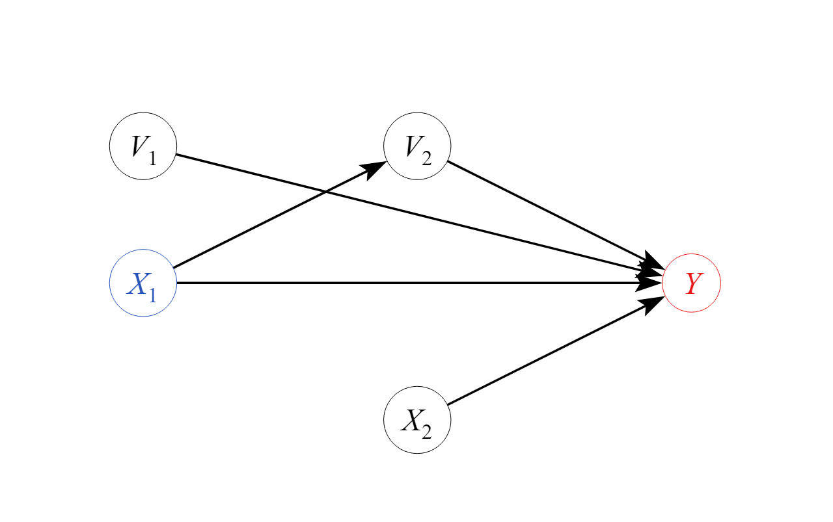

Slide 72
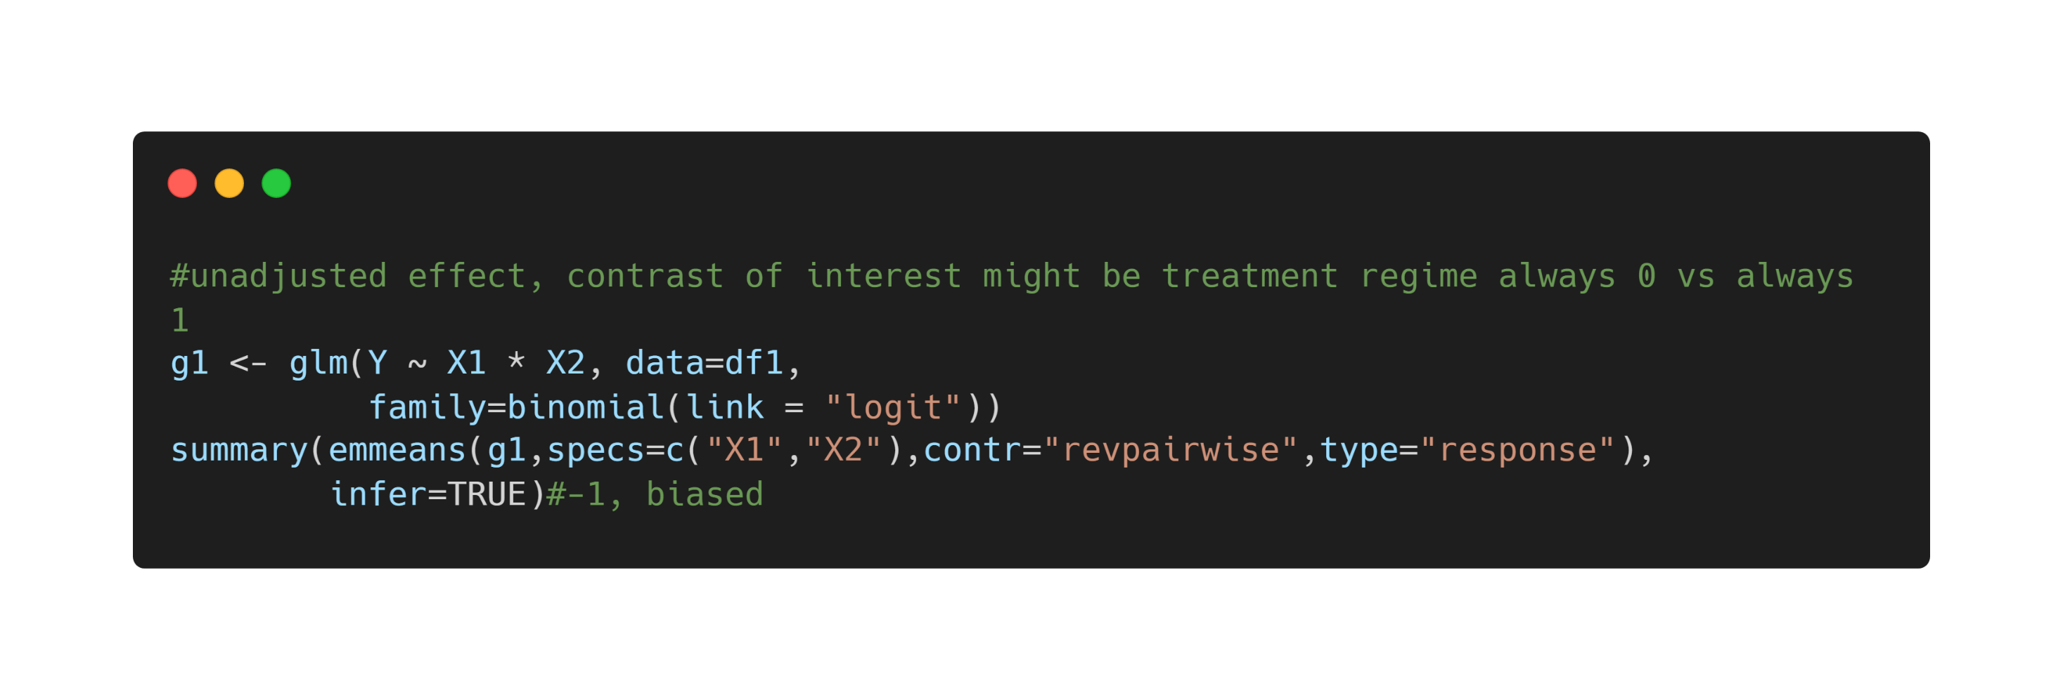

Slide 73
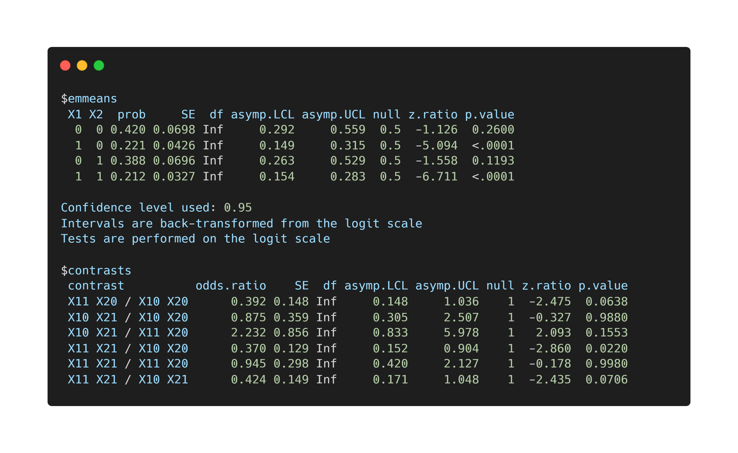

Slide 74
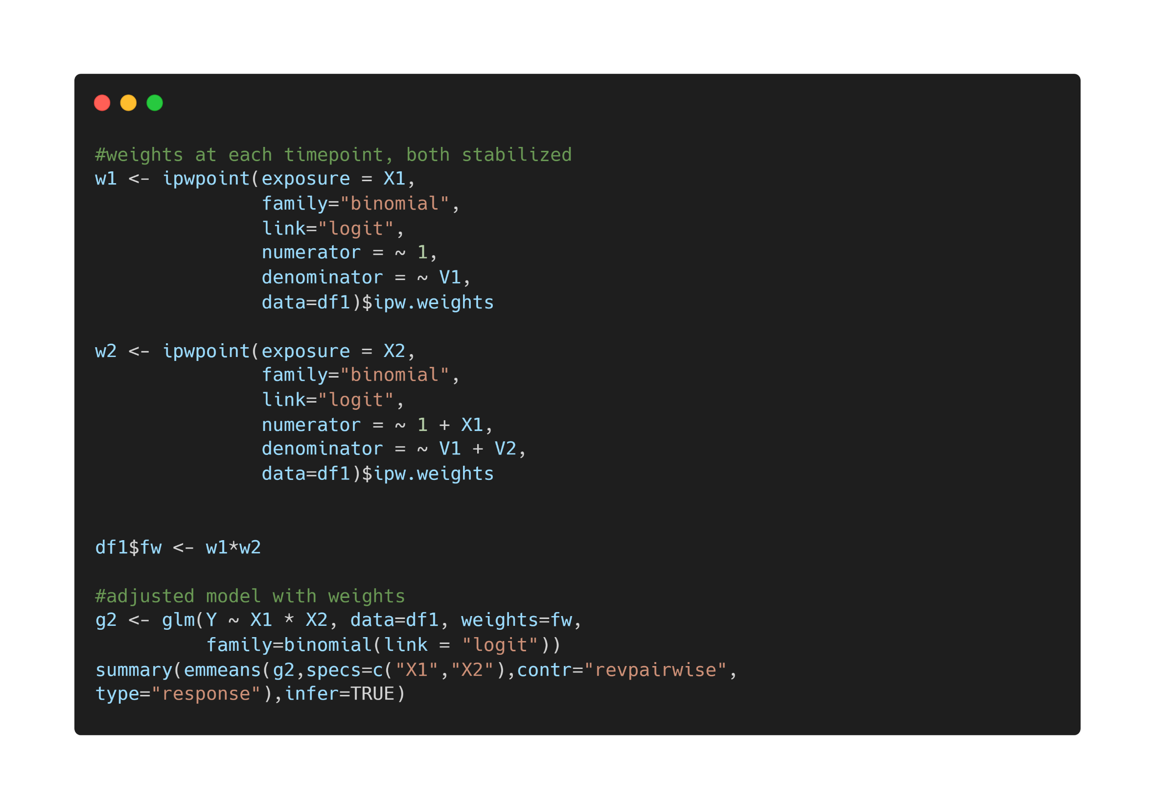

Slide 75
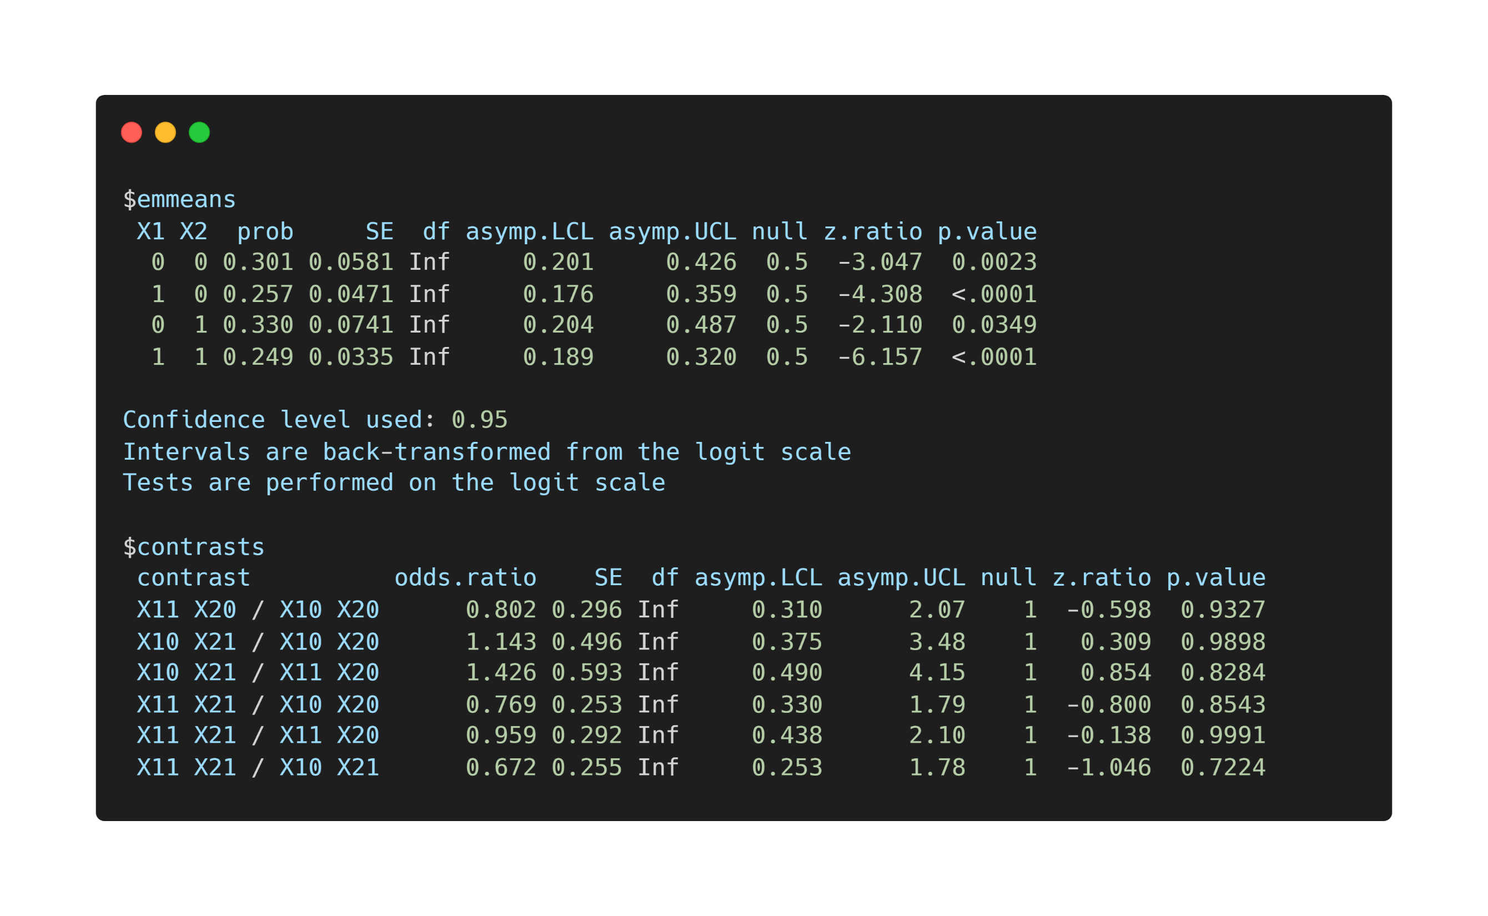

Slide 76
Final Exercise

Slide 77
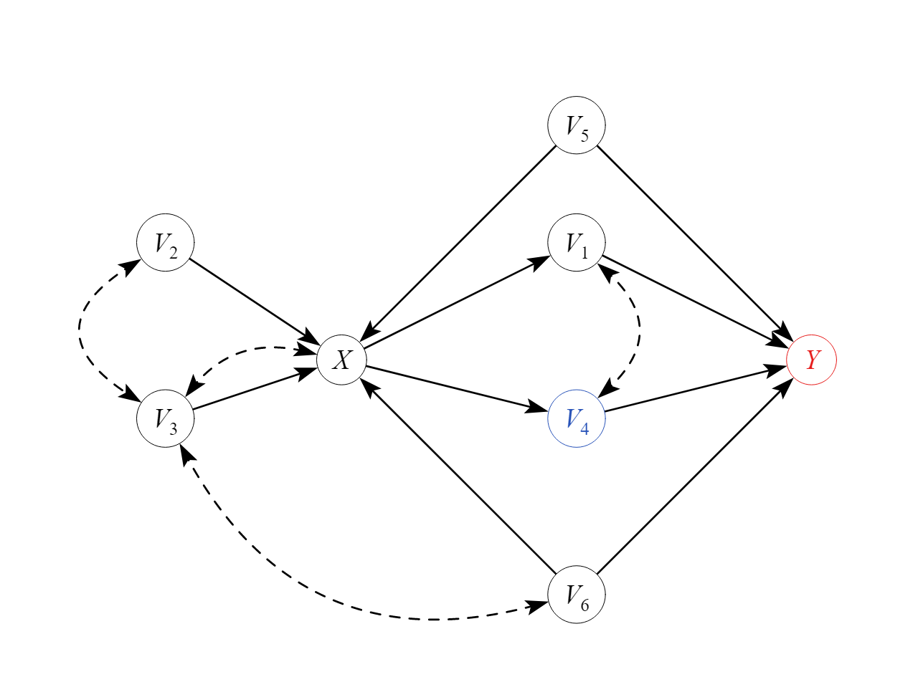
Datenbeispiel

Slide 78
https://github.com/felixthoemmes/dfg_netzwerk_2022_mannheim

Slide 79
Schlusswort
Kausal Inferenz ist notwendig zur Bildung von Theorien
Klarheit des kausalen Estimanden und der kausal Annahmen müssen transparent kommuniziert werden
Bestimmte Annahmen suggerieren bestimmte analytische Ansätze

Slide 80






Suggested readings

Slide 81

felix.thoemmes@cornell.edu felixthoemmes.com @felixthoemmes

Slide 83
Extras

Slide 84
τ = τ* ?
“Causation ≠ Association”
Causal identification

Slide 85



CONTROL
TREATMENT
CONTROL
TREATMENT
E(Y_{i1}) = E(Y_{i1} | z_{i} = 1)
E(Y_{i0}) = E(Y_{i0} | z_{i} = 0)
E(Y_{i1}) ≠ E(Y_{i1} | z_{i} = 1)
E(Y_{i0}) ≠ E(Y_{i0} | z_{i} = 0)

Slide 86
E(Y_{i1}) = E(Y_{i1} | z_{i} = 1) Randomized experiment
E(Y_{i0}) = E(Y_{i0} | z_{i} = 0)
E(Y_{i1}) ≠ E(Y_{i1} | z_{i} = 1) Non-randomized E(Y_{i0}) ≠ E(Y_{i0} | z_{i} = 0) experiment

Slide 87
E(Y_{i1}) = E_{x}{E(Y_{i1} | z_{i} = 1, x)} Non-randomized E(Y_{i0}) = E_{x}{E(Y_{i0} | z_{i} = 0, x)} experiment with unconfoundedness assumption
X contains all confounding covariates
Conditional ignorabilty (Rubin, 194)

Slide 88
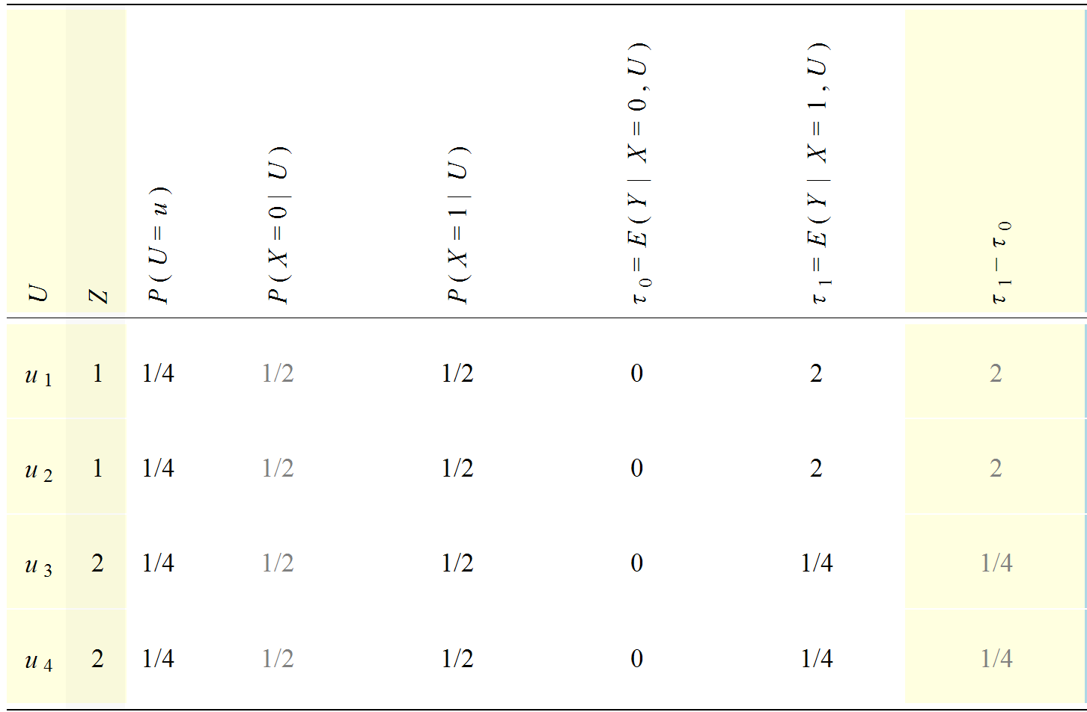
https://www.metheval.uni-jena.de/projekte/book_causal-effects/tools.php

Slide 89
Z | T | Y0 | Y1
1 | 0 | 0 | ●
1 | 1 | ● | 2
1 | 0 | 0 | ●
1 | 1 | ● | 2
2 | 0 | 0 | ●
2 | 1 | ● | 1/4
2 | 0 | 0 | ●
2 | 1 | ● | 1/4
 |  | 0 | 1.125

Slide 90
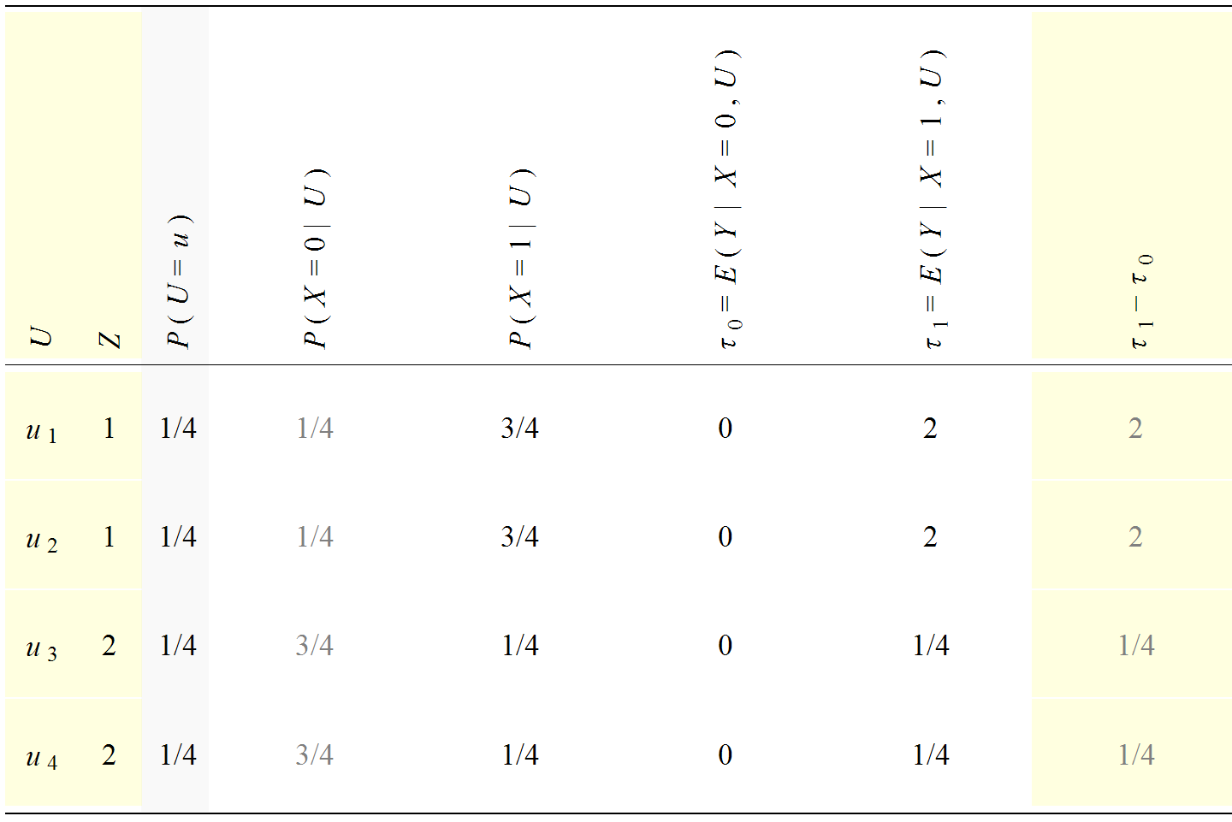

Slide 91
Z | T | Y0 | Y1
1 | 1 | ● | 2
1 | 1 | ● | 2
1 | 1 | ● | 2
1 | 0 | 0 | ●
2 | 0 | 0 | ●
2 | 0 | 0 | ●
2 | 0 | 0 | ●
2 | 1 | ● | 1/4
 |  | 0 | 1.562

Slide 92
Z | T | Y0 | Y1
1 | 1 | ● | 2
1 | 1 | ● | 2
1 | 1 | ● | 2
1 | 0 | 0 | ●
2 | 0 | 0 | ●
2 | 0 | 0 | ●
2 | 0 | 0 | ●
2 | 1 | ● | 1/4
 |  | 0 | 1.562

Slide 93
Z | T | Y0 | Y1
1 | 1 | ● | 2
1 | 1 | ● | 2
1 | 1 | ● | 2
1 | 0 | 0 | ●

Slide 94
Z | T | Y0 | Y1
2 | 0 | 0 | ●
2 | 0 | 0 | ●
2 | 0 | 0 | ●
2 | 1 | ● | 1/4

Slide 95
Z | T | Y0 | Y1
2 | 0 | 0 | 1/4
2 | 0 | 0 | 1/4
2 | 0 | 0 | 1/4
2 | 1 | 0 | 1/4
 |  | 0 | .25
Z | T | Y0 | Y1
1 | 1 | 0 | 2
1 | 1 | 0 | 2
1 | 1 | 0 | 2
1 | 0 | 0 | 2
 |  | 0 | 2
(.25 + 2) / 2 = 1.125

Slide 96
Z | T | Y0 | Y1
1 | 1 | 0 | 2
1 | 1 | 0 | 2
1 | 1 | 0 | 2
1 | 0 | 0 | 2
 |  | 0 | 2

Slide 97
Z | T | Y0 | Y1
2 | 0 | 0 | 1/4
2 | 0 | 0 | 1/4
2 | 0 | 0 | 1/4
2 | 1 | 0 | 1/4
 |  | 0 | .25

Slide 98
Z | T | Y0 | Y1
2 | 0 | 0 | 1/4
2 | 0 | 0 | 1/4
2 | 0 | 0 | 1/4
2 | 1 | 0 | 1/4
 |  | 0 | .25
Z | T | Y0 | Y1
1 | 1 | 0 | 2
1 | 1 | 0 | 2
1 | 1 | 0 | 2
1 | 0 | 0 | 2
 |  | 0 | 2
(.25 + 2) / 2 = 1.125

Slide 99
Adjustment
In the previous slide we saw the fundamental idea behind adjustment
Using a model (here just modeling means within strata of a covariate) and estimating effects within strata of units that are identical
We may also use this model to estimate potential outcomes
Conditional ignorability must hold

Slide 100
Statistical aspects of adjustment
Research manuscripts often mention that variables were adjusted on, or controlled for
What exactly does it mean to control for something?

Slide 101
Statistical aspects of adjustment
In many instances adjustment or controlling for is synonymous with adding a covariate (a potential confounder) to a linear regression model
But other adjustment techniques also exist (matching, weighting)
We will cover all three of them

Slide 102
Statistical aspects of adjustment
Consider that we are interested in the causal effect of a non-randomized treatment
We have covariates at our disposal, and through the use of theory (and maybe a DAG) we feel confident that we have a set of covariates that would fulfill ignorability
How do we adjust on these variables?

Slide 103
Simple example
A non-randomized treatment that hopes to increase academic achievement is offered to a group of students
Students select into treatments and consequently end up differing on important pre-test covariates
One of them is prior academic achievement

Slide 104
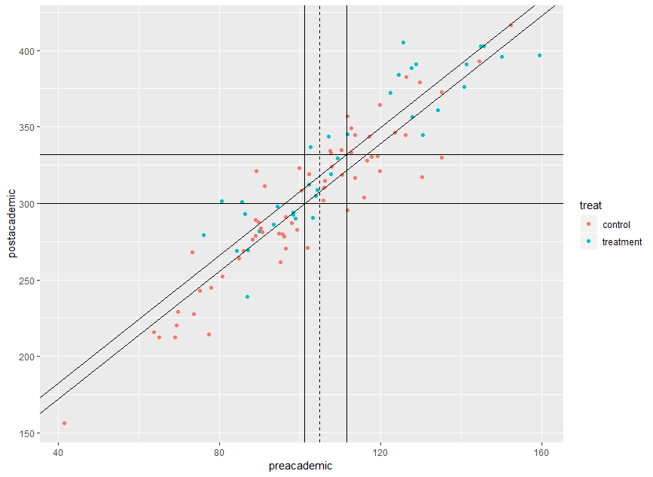

Slide 105
Simple example
Comparison of groups that differ in treatment status AND at the same time differ on their pre-treatment achievement
How would the means of the two groups look like if the pre-treatment achievement scores were identical? (e.g., both were on the overall mean)

Slide 106
Simple example
Using a model (e.g., a parametric linear regression model) we can predict what the post-test score of a unit would be if assigned to the treatment group, or the control group, given values on pre-academic achievement
These predictions emerge from a model, hence this is referred to as model-based adjustment

Slide 107
Simple example
We can use the regression equation to predict the post-test academic achievement for each person, under both control and treatment
From these individual values, we can aggregate means, which are referred to as “adjusted means”
This model is essentially identical to the ANCOVA model

Slide 108
Simple example
Differences between these adjusted means are adjusted treatment effects
They answer the question what the treatment effect would be, if we compared similar units or observed every potential outcome (which we do not)

Slide 109
Simple example
It is possible to obtain these treatment effects directly from the (summary) output of a regression model
This however only works in simple (linear, non-interactive) models
More complicated models (with interactions, non-linear effects) require some type of post-processing of the regression estimates

Slide 110
Simple example
R has various packages that perform this type of analysis
margins – general package for average effects (based on Stata’s margins command)
EffectLiteR – powerful package for causal effects using multi-group SEM
tlme – package for G-estimation, especially useful for doubly robust methods and flexible estimation
emmeans – general purpose package for post-processing regression results with categorical treatment variables

Slide 111
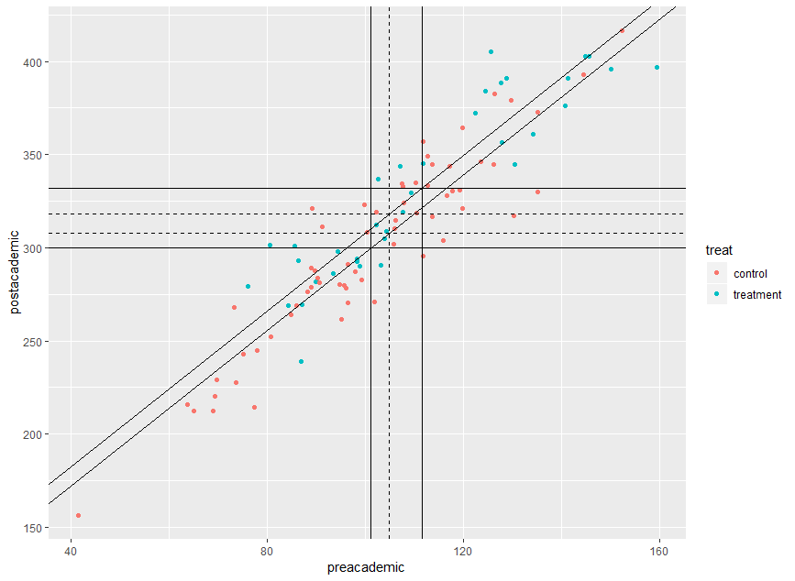
emmeans example
Same example of post-academic achievement, and the effect of treatment, adjusted on pre-academic achievement

Slide 112

emmeans

Slide 113

Regression and predicted values

Slide 114
Regression and predicted values

Slide 115

emmeans

Slide 116
ANCOVA
Linearity assumption needs to be confirmed
But can be relaxed
No-interaction assumption needs to be confirmed
But can be relaxed

Slide 117
ANCOVA
How do we know whether a non-linear effect or an interaction is needed?
Regression diagnostics
Machine learning to circumvent the whole process of selecting functional forms and checking them (tmle SuperLearner)

Slide 118


Slide 119
Effect estimation
In the presence of non-linear effects, and interactions, typical regression summaries do not show the treatment effect
The treatment effect can still be derived by generating predicted values for each unit under treatment and under control (and then computing differences, and aggregates of differences)
It is also possible to obtain the same estimates by evaluating group mean differences at the mean value of all covariates
emmeans can do this for us

Slide 120


Slide 121
Categorical covariates
The same principle applies if the covariate happens to be categorical and not continuous
We can still predict outcomes under all combinations of covariate levels, and treatment assignments
emmeans treats categorical predictors properly (for causal inference purposes) if we use the weights=“proportional” option

Slide 122
ANCOVA
Additional assumption that there is sufficient overlap (positivity)
Adjusted means represent predictions based on observed regression slopes
These predictions can be far outside the “region of common support”

Slide 123
ANCOVA
Imagine adjusting for many variables
Groups should have some overlap otherwise adjusted means are extrapolated into regions where potentially no data is observed
One way to confront this is to restrict estimation of a causal effect for region in which there is overlap

Slide 124
Convex hull
The convex hull is an area that is defined by the outer limits of a point cloud in multi-dimensional space
We can restrict our analysis to those units that are assigned to one treatment, but still fall in the convex hull of the other units
That way, we never extrapolate in regions that are completely sparse and only exclusively inhabited by one or the other group

Slide 125
Convex hull
Gary King gives an example on the causal effect of effects of democracies vs autocracies
The counterfactual of autocratic Poland in 1990 lies within the range of other democracies
The counterfactual of democratic Canada in 1995 lies far outside the range of other autocracies

Slide 126


Slide 127
Convex hull
Restricting the analysis to points that lie inside the region of common support reduces model dependency
That means that slightly mis-specified models do not have very severe consequences (more robust)
It also forces us to realize that there are points for which causal inference is unstable

Slide 128


Slide 129
Regression adjustment workflow
Selection
Residual Checks
Model estimation
Effect Estimation

Slide 130
Matching

Slide 131
Matching
In the previous section on adjustment we used a parametric model to predict potential outcome
Instead of using a model, we may choose to try to find pairs of variables that are identical (on covariates) but differ on treatment assignment, so that they can serve as the missing potential outcome for each other

Slide 132
Z | T | Y0 | Y1
1 | 1 | ● | 2
1 | 1 | ● | 2
1 | 1 | ● | 2
1 | 0 | 0 | ●
2 | 0 | 0 | ●
2 | 0 | 0 | ●
2 | 0 | 0 | ●
2 | 1 | ● | 1/4
 |  | 0 | 1.562

Slide 133
Z | T | Y0 | Y1
1 | 1 | ● | 2
1 | 0 | 0 | ●
2 | 0 | 0 | ●
2 | 1 | ● | 1/4
 |  | 0 | 1.125

Slide 134
Z | T | Y0 | Y1
1 | 1 | 0 | 2
1 | 0
2 | 0 | 0 | 1/4
2 | 1
 |  | 0 | 1.125

Slide 135
Matching
An obstacle to matching is that if we have many covariates (and usually we want that, because otherwise ignorability does not hold), the region of common support gets very small
Same issue with convex hull that restricted adjustment to region of common support
Some consider this an advantage, because that means with a matching estimator you virtually never extrapolate

Slide 136
Matching
Consider that we have 16 covariates
8 of them are binary which means 2^8 = 256 combinations
The remaining 8 are continuous and in order to match them, we discretize them into 3 categories each (low, medium, high), so 6561 combinations
Together we have well over a million different combinations of covariate levels – if at a minimum we want at least 1 treated and 1 untreated person in each combination we need a sample size of at least 2 – 3 millions

Slide 137
Propensity scores
z = treatment assignment 1 = treatment group 0 = control group
Propensity score
conditional on
controlled for
e(x) = p (z=1 | x)
probability
x = vector of covariates

Slide 138
Propensity scores
e(x) = p (z=1 | x)
A single number summary based on all available covariates that expresses the probability that a given subject is assigned to the treatment condition, based on the values of the set of observed covariates

Slide 139
Propensity scores
Actual assignment
Actual assignment
Control
Treatment
Control
Treatment
Likelihood of receiving treatment
Likelihood of receiving treatment

Slide 140
Example of balance property
original sample
a | b | z | e(x)
0 | 0 | 0 | .5
0 | 0 | 1 | .5
1 | 0 | 0 | .33
1 | 0 | 0 | .33
1 | 0 | 1 | .33
0 | 1 | 0 | .66
0 | 1 | 1 | .66
0 | 1 | 1 | .66
1 | 1 | 1 | 1
1 | 1 | 1 | 1
e(x) = p(z=1| x={0 0}) = .5
e(x) = p(z=1| x={1 0}) = .33
e(x) = p(z=1| x={0 1}) = .66
e(x) = p(z=1| x={1 1}) = 1
(a=1 | z=0) = .5
(b=1 | z=0) = 1/4
(a=1 | z=1) = .5
(b=1 | z=1) = .66

Slide 141
Example of balance property
matched sample
a | b | z | e*(x)
0 | 0 | 0 | .5
0 | 0 | 1 | .5
1 | 0 | 0 | .5
1 | 0 | 1 | .5
0 | 1 | 0 | .5
0 | 1 | 1 | .5
p(z, x|e(x)) = p(z |e(x)) p(x |e(x))
Examples for z=1 and x = {0 1}
p(z=1, x={0 1}|e(x)) = 1/6
p(z=1 |e(x)) = .5
p(x={0 1} |e(x)) = .33
p(z |e(x)) p(x |e(x)) = (.5)(.33) = 1/6
(a=1 | z=0) = .5
(b=1 | z=0) = .5
(a=1 | z=1) = .5
(b=1 | z=1) = .5

Slide 142
Propensity scores
Balance on the propensity score implies on average balance on all observed covariates
Importantly, PS matching generates balance in the distributions of covariates, and not necessarily for each single pair of unit

Slide 143
Propensity score
Propensity score models influence of confounders on treatment assignment
In comparisons, ANCOVA models influence of confounders on outcome
Confounder
Treatment
Outcome

Slide 144
Propensity scores | Regression adjustment
Tool to strengthen causal conclusions | Tool to strengthen causal conclusions
Models relationship between confounders and treatment | Models relationship between confounders and outcome
No assumption about functional form of propensity score | Classic ANCOVA assumes lineartiy and absence of interaction, but can be extended
Outcome variable unknown during propensity score analysis | Outcome variable always part of the adjustment
Sample size can be diminished, loss of power | Sample size stays constant, power can increase due to covariates

Slide 145
Matching
Just like there are modeling choices in the estimation of the outcome model in ANCOVA, so are there choices in the estimation of the propensity score, and the type of matching that is performed
The propensity score is typically estimated using a logistic regression (predicting treatment assignment from covariates), but one could also use machine learning algorithms

Slide 146
Propensity Score
Predicting Selection
Confounder
Predicting Outcome
Treatment
Outcome
Select true confounders and covariates predictive of outcome (back-door criterion, ignorability)

Slide 147
Propensity Score
Estimation of propensity scores can be achieved in numerous ways
Logistic regression
Discriminant analysis
(Boosted) regression trees

Slide 148
Propensity Score
Logistic regression model
Outcome is treatment assignment
Predictors are covariates
can be overfitted to the sample, e.g. include interactions, higher order terms
only interest is prediction and covariate balance
= β₀ + β_{i} X

Slide 149
Propensity Score
Various matching algorithm (full matching, optimal matching, etc.)
Too many to discuss, but here are some of the classic ones
In our exercise, we will mostly use classic matching methods

Slide 150
NN - matching
Nearest-neighbor matching (NN)
Participants are ordered and then one after the other is matched to the unit with the closest propensity score
With or without replacement (sample size bias tradeoff)
1:1 or 1:k matching
With our without caliper (avoids bad matches)

Slide 151
Kernel - matching
Match every unit in one condition to a single unit in the other condition, but weight the matched units by their distance
Weighting is defined through the kernel function (essentially bandwidth parameter)

Slide 152
Trade-offs
 | Bias | Variance
1:1 1:k | ↓ ↑ | ↑ ↓
Caliper No caliper | ↓ ↑ | ↑ ↓
Replacement No Replacement | ↓ ↑ | ↑ ↓
NN Kernel | ↓ ↑ | ↑ ↓
Small bandwidth Large bandwidth | ↓ ↑ | ↑ ↓
Source: Caliendo and Kopeinig, 2005

Slide 153
Propensity Score
Check of covariate balance
standardized difference
graphical assessment (e.g. Q-Q plot)
Region of common support (distributional overlap)
graphical assessment (e.g. histograms)

Slide 154

Propensity Score
Before Matching
After Matching
Logit Propensity Score Treatment Group
Quantiles of both distributions are plotted against each other
Logit Propensity Score Control Group

Slide 155
Propensity Score
Before Matching
After Matching

Slide 156
Density
Density of scores
for non-
participants
Density of scores for participants
Region of common support
0
High probability of participating given X
Propensity score
1

Slide 157
Propensity Score
Estimate of treatment effect
Mean difference
Standard error dependent on conditioning scheme (dependent sample standard error or bootstrapping)

Slide 158
Packages
R has various packages that perform this type of analysis
MatchIt – general and flexible package for matching estimators
EffectLiteR – allows inclusion of propensity score in estimation
tlme – allows inclusion of propensity score in estimation
PSAgraphics – package for visualization

Slide 159
Propensity Score Workflow
Selection
Balance Checks
PS Estimation
Matching
Effect Estimation

Slide 160
Weighting

Slide 161
Weighting
Another idea to adjust for confounding influences is to weight the observed population in a way that creates a “pseudo-population” in which the covariate and the treatment are independent of each other
In such a pseudo-population, there is no more confounding
This could mean that one person gets counted 4 times in a sample, while another person only gets counted ¼ of a time

Slide 162
Propensity scores | Regression adjustment | IPTW
Tool to strengthen causal conclusions | Tool to strengthen causal conclusions | Tool to strengthen causal conclusions
Models relationship between confounders and treatment | Models relationship between confounders and outcome | Construct weights based on confounder and treatment
No assumption about functional form of propensity score | Classic ANCOVA assumes lineartiy and absence of interaction, but can be extended | No assumption about functional form of weight equation
Outcome variable unknown during propensity score analysis | Outcome variable always part of the adjustment | Outcome variable unknown during weight construction
Sample size can be diminished, loss of power | Sample size stays constant, power can increase due to covariates | Sample size stays constant, but weights induce uncertainty in estimate

Slide 163
Z | T | Y0 | Y1
1 | 1 | ● | 2
1 | 1 | ● | 2
1 | 1 | ● | 2
1 | 0 | 0 | ●
2 | 0 | 0 | ●
2 | 0 | 0 | ●
2 | 0 | 0 | ●
2 | 1 | ● | 1/4
 |  | 0 | 1.562

Slide 164
Z | w | T | Y0 | Y1
1 | 1.33 | 1 | ● | 2
1 | 1.33 | 1 | ● | 2
1 | 1.33 | 1 | ● | 2
1 | 4.00 | 0 | 0 | ●
2 | 1.33 | 0 | 0 | ●
2 | 1.33 | 0 | 0 | ●
2 | 1.33 | 0 | 0 | ●
2 | 4.00 | 1 | ● | 1/4
 |  |  | 0 | 1.125
((2 × 1.33) × 3 + (.25 × 4)) / 8 = 1.125
(0 * 1.33) × 3 + (0 × 4) / 8 = 0

Slide 165

Weighting
Each unit is weighted by the inverse of the probability of being assigned to its treatment, given the covariate values
The denominator of this formula is the propensity score

Slide 166
Weighting
A unit that has covariate values that make it very likely to be in the actual assigned group ends up getting a small weight
A unit that has covariate values that make it very unlikely to be in the actual assigned group ends up getting a large weight
Rare units in the control are up-weighted, and common units down-weighted, and likewise in the treatment
This creates pseudo-populations in which the covariates are equally distributed

Slide 167
Statistical aspects of weighting
Using weights can have some undesirable consequences in small samples
Very rare units can get tremendous weight, and thus making the estimate highly dependent on that particular unit

Slide 168

Statistical aspects of weighting
The use of so-called stabilized weights, and weight truncation is encouraged

Slide 169
Z | w | T | Y0 | Y1
1 | .666 | 1 | ● | 2
1 | .666 | 1 | ● | 2
1 | .666 | 1 | ● | 2
1 | 2.00 | 0 | 0 | ●
2 | .666 | 0 | 0 | ●
2 | .666 | 0 | 0 | ●
2 | .666 | 0 | 0 | ●
2 | 2.00 | 1 | ● | 1/4
 |  |  | 0 | 1.125
((2 × .666) × 3 + (.25 × 2)) / 4 = 1.125
(0 * .666) × 3 + (0 × 2) / 4 = 0
Note that stabilized weights preserve the sample size.

Slide 170
Statistical aspects of weighting
Truncation of the weights means that very large weights are scaled down to some pre-specified percentile
This essentially protects against outliers
Commonly used percentiles are the 1% and 99% percentile

Slide 171
Statistical aspects of weighting
The outcome analysis is then performed by using a parametric model with the weights
E.g., weighted least squares
Because the estimation of the weights is itself subject to random variability, it is recommended to use robust standard errors for frequentist inference

Slide 172
Statistical aspects of weighting
What makes inverse-probability weighting such a powerful technique is that it can also be used for time-varying treatments
The use of these weights in longitudinal data is in the literature often referred to as a marginal structural model

Slide 173
Packages
R has one package that perform this type of analysis
ipw – general and flexible package for weighting estimators

Slide 174
Weighting workflow
Selection
Weight Checks
Weight Estimation
Effect Estimation

Slide 175
Combining methods

Slide 176
Combining methods
The discussed methods can be used in conjunction with each other
It is possible to first match participants, and then use regression adjustment to model the outcome
Likewise it is also possible to construct weights, and then use regression adjustment to model the outcome

Slide 177
Combining methods
An interesting property of this approach is that BOTH the relationship between confounders and treatment assignment AND the relationship between confounders and the outcome is modeled
Confounder
Treatment
Outcome

Slide 178
Combining methods
It turns out that if only one of the two models is correct, we still get unbiased estimates
This property is known as “doubly-robust”
Confounder
Treatment
Outcome

Slide 179
Other identification strategies

Slide 180
Selection on observables
So far all of our models were based on the assumption that we can achieve ignorability (back-door criterion)
But what if that assumption is not really credible?

Slide 181
Other assumptions
We can try to make other causal assumptions that do not rely on having observed all confounders
Whether these assumptions are more or less plausible is always a matter of theory and debate

Slide 182
Instrumental variables
One such causal assumption is that we are able to identify one (or more) variables that are so-called instruments
Confounder
Instrument
Treatment
Outcome

Slide 183
Instrumental variables
An instrument has an effect on the treatment (may or may not be causal)
An instrument is unrelated to the confounders
An instrument does not have a direct effect on the outcome (exclusion restriction)
Confounder
Instrument
Treatment
Outcome

Slide 184
Instrumental variables
Examples:
Randomized treatment assignment in which not everybody responds to treatment. Smoking cessation program -> Smoking frequency -> birth weight
Distance from hospital as instrument for causal relationship between home birth and birth complications

Slide 185
Instrumental variables
IV estimates identify a causal effect for individuals “who can be induced to change [treatment] status by a change in the instrument”
Local treatment effect is instrument-dependent, meaning that one and same effect with different instruments will give different results

Slide 186
Instrumental variables
IV can be estimated through 2-stage least-squares regression or using structural equation models
It is customary to statistically compare estimates from an unadjusted model with those from the IV model (Hausman test)
Also report the significance of the relationship between instrument and putative cause
If more than one IV is available, then one can test whether the IV is correlated with the error of the outcome (Sargan test)

Slide 187
Mechanisms
Similar in spirit to instrumental variables, one may find a unique mechanism (psychologists would call it full mediation)
Cause
Mech
Outcome

Slide 188
Mechanisms
Despite unobserved confounding between the cause and the outcome, the presence of a mechanism allows us to compute the total causal effect
Cause
Mech
Outcome

Slide 189
Mechanisms
The mechanism must not be related to the unobserved confounders
The cause must not directly cause the outcome, only via the mechanism
Cause
Mech
Outcome

Slide 190
Statistical aspects of mechanisms
One way to estimate the causal effect via a mechanism is to simply use a structural equation model (path model)
We define a full mediation model, but allow the error terms of treatment and outcome to be correlated
This yields a just-identified model from which we can derive the total effect as the product of the two paths (assuming linear models)

Slide 191
Complications
Latent variables
Missing data
Machine learning
Longitudinal data
Indirect effects

Slide 192
Latent variables
All of our examples so far used manifest variables
What if some of our constructs are latents and we want to model them this way
Use of full structural equation model (with measurement model) necessary, but many questions remain
EffectLiteR currently only package that tackles these issues

Slide 193
Missing data
All of our examples assumed complete data
Missing data can induce unique biases even in perfectly unconfounded effects
Identification of missingness mechanism (m-graphs) and techniques to recover effects (imputation) rely on additional assumptions

Slide 194
Machine learning
All of our exercises were fitted “manually”, entering covariates and doing some model checks
In complex models this seems hopeless
Machine learning algorithms could potentially help here
Some success stories with Bayesian Regression Trees, and SuperLearner (in tmle package)

Slide 195
Longitudinal data
All of our exercises considered a treatment being administered at one point in time
Longitudinal studies with time-varying treatments, and time-varying confounders pose additional problems
Regression adjustment and matching often infeasible, weighting and marginal structural models possible (in ipw package)

Slide 196
Indirect effects
All of our exercises considered the total effect of a treatment
Sometimes we are interested in mechanisms of a treatment (opening the black box)
This translates into indirect (mediated) effects
Flurry of literature on this topic, incuding necessary assumptions, estimation strategies, and designs (in Mediation package)

